Slide 1
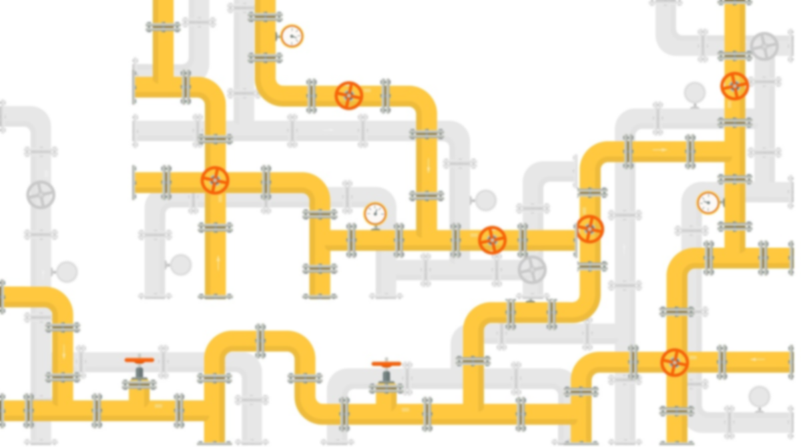
Big Data Pipeline
GGE 6505/GGE5405 Introduction to Big Data & Data Science

Slide 2
Big Data Concepts and Terminology
Clustered computing
Distributed computing
Distributed file system
ETL
Data lake and data warehouse
Notes:
Cluster collection of resources of multiple machine

Slide 3
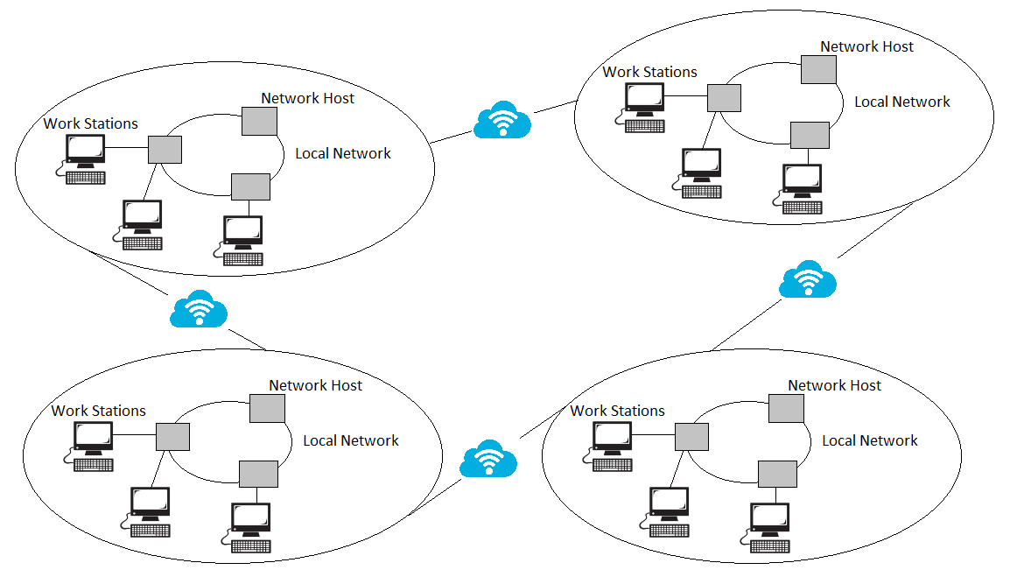
1- Distributed Computing
A distributed computer system consists of multiple software components that are on multiple computers, but run as a single system. The computers that are in a distributed system can be physically close together and connected by a local network, or they can be geographically distant and connected by a wide area network. → collection of nodes that run parallelly!
The goal of distributed computing is to make such a network work as a single computer.
Scalability: The system can easily be expanded by adding more machines as needed.
Redundancy: Several machines can provide the same services, so if one is unavailable, work does not stop.
Notes:
Distributed computing (or distributed processing) is the technique of linking together multiple computer servers over a network into a cluster, to share data and to coordinate processing power
cloud computing??? provides the software, hardware with complete infrastructure over the internet while distributed computing is dividing tasks into different computing machines that are connected through a network
---------------------
The system is dispersed for a regular user, and the system is connected to multiple nodes that execute the assigned computer duties. The system is distributed as a single system. Consider from the user’s perspective the Google web server. Users are satisfied that the Google Web Server is a single system where they need to login and look for the needed phrase when submitting a search query

Slide 4
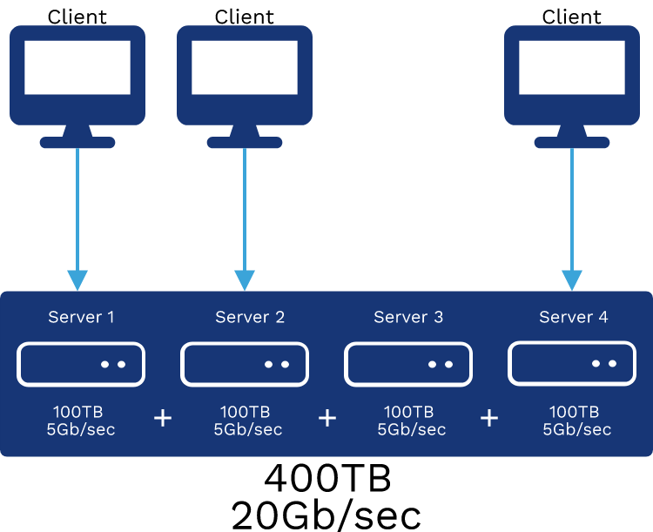
2- Distributed File Systems (DFS)
It is distributed on multiple file servers or multiple locations. It allows programs to access or store isolated files as they do with the local ones, allowing programmers to access files from any network or computer.
Applications :
NFS:NFS stands for Network File System. It is a client-server architecture that allows a computer user to view, store, and update files remotely. The protocol of NFS is one of the several distributed file system standards for Network-Attached Storage (NAS).
Hadoop: Hadoop is a group of open-source software services. It gives a software framework for distributed storage and operating of big data using the MapReduce programming model. The core of Hadoop contains a storage part, known as Hadoop Distributed File System (HDFS), and an operating part which is a MapReduce programming model.
Notes:
The purpose of a distributed file system (DFS) is to allow users of distributed computers to share data and storage resources by using a common file system
Advantages :
DFS allows multiple user to access or store the data.
It allows the data to be share remotely.
Disadvantages :
In Distributed File System nodes and connections needs to be secured
There is a possibility of lose of messages and data in the network while movement from one node to another.

Slide 5
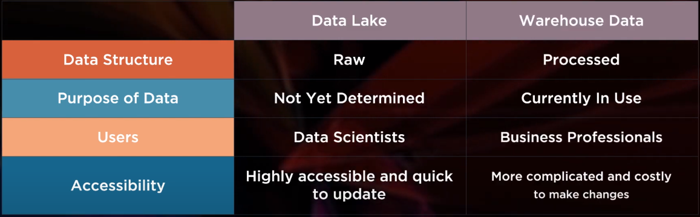
3- Data warehouse and Data lake
Data lakes and data warehouses are both widely used for storing big data, but they are not interchangeable terms. A data lake is a vast pool of raw data, the purpose for which is not yet defined. A data warehouse is a repository for structured, filtered data that has already been processed for a specific purpose.

Slide 6
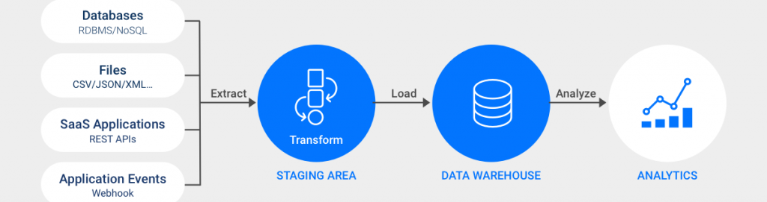
4- ETL
ETL is a data integration process that combines data from multiple data sources into a single, consistent data store that is loaded into a target system.
EXTRACT data from its original source
TRANSFORM data by deduplicating it, combining it, and ensuring quality, to then
LOAD data into the target database
Notes:
During data extraction, raw data is copied or exported from source locations to a staging area. Data can extract from a variety of data sources, which can be structured or unstructured
Transform
the data is transformed and consolidated for its intended analytical use case. This phase can involve Filtering, cleansing, de-duplicating, validating, and authenticating the data
Load
In this last step, the transformed data is moved from the staging area into a target data warehouse.

Slide 7
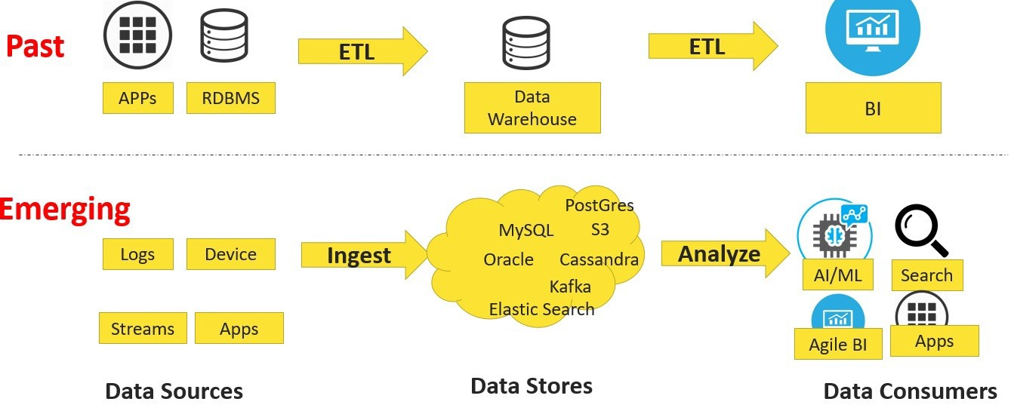
Evolution of Data
(93) Understanding the basics of any IoT data pipeline — from ingress capture to processing to generation of value (Part 1) | by Ravi Kumar. | Products, Platforms, Business & Innovation in Industry 4.0/IIoT | Medium
Notes:
Data pipeline has changed since its very beginning.
Earlier ETL tools were used to move data from relational databases/data sources into enterprise data warehouse and analytics was done using BI tools. The challenge of previous pipeline was that the data was structured, that is it could be neatly represented in rows and columns, but it could not process unstructured data like audio and images. The other challenge was the speed and scalability of processing.

Slide 8
Big Data Pipeline
Big data pipelines are data pipelines built to accommodate one or more of the three traits of big data:
The velocity of big data → makes it appealing to build streaming data pipelines for big data.
The volume of big data → requires that data pipelines must be scalable, as the volume can be variable over time
The variety of big data → requires that big data pipelines be able to recognize and process data in many different formats
Notes:
The velocity of big data makes it appealing to build streaming data pipelines for big data. Then data can be captured and processed in real time so some action can then occur.
The volume of big data requires that data pipelines must be scalable, as the volume can be variable over time. For exapmple , there are likely to be many big data events that occur simultaneously or very close together, so the big data pipeline must be able to scale to process significant volumes of data concurrently.
The variety of big data requires that big data pipelines be able to recognize and process data in many different formats—structured, unstructured, and semi-structured.

Slide 9
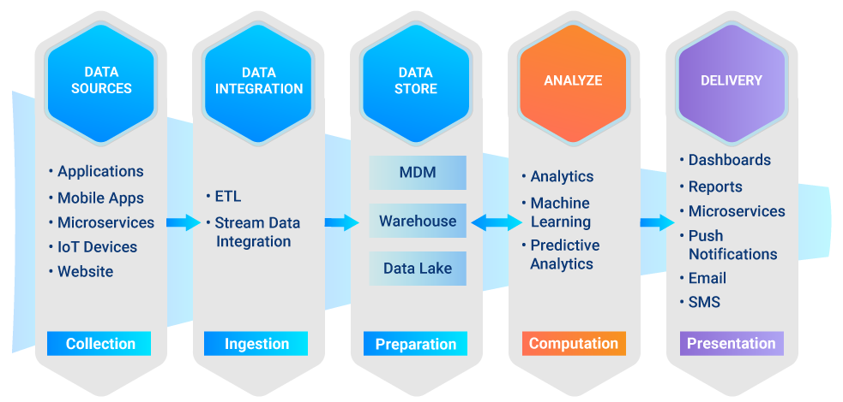
Big Data Pipeline
Notes:
In general there are some common ecosystem layers:
Data ingestion layer (Reading data from data sources): there are many tools such as Apache Kafka, Sqoop and others.
Data preparation or Processing layer (Data cleansing, aggregation): Apache Spark, Storm, Hive, Pig, MapReduce …
Raw Data storage (Data lake which stores ingested data without as it comes): Hadoop
Processed Data storage (Database , Data warehouse which stores data after being processed and cleaned): Apache Cassandra, InfluxDb, MongoDB, Apache Hive …
Data presentation layer (Drawing real-time graphs): Kibana, Grafana …

Slide 10
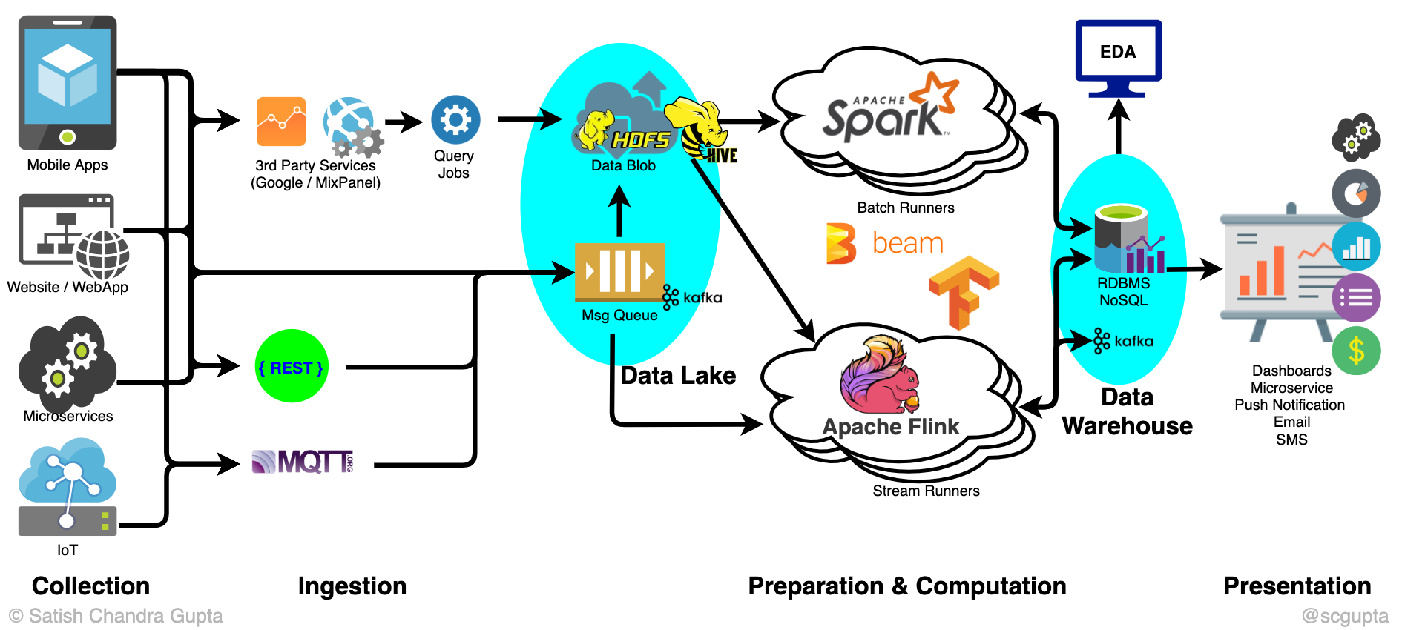

Slide 11
Big Data Architecture
Data pipelines may be architected in several different ways.
Batch-based data pipeline
Streaming data pipeline
Lambda architecture
What Is A Data Pipeline? Considerations & Examples - Hazelcast
Notes:
Data pipelines may be architected in several different ways.
One common example is a batch-based data pipeline
Another example is a streaming data pipeline
A third example of a data pipeline is the Lambda Architecture, which combines batch and streaming pipelines into one architecture. The Lambda Architecture is popular in big data environments because it enables developers to account for both real-time streaming use cases and historical batch analysis. One key aspect of this architecture is that it encourages storing data in raw format so that you can continually run new data pipelines to correct any code errors in prior pipelines, or to create new data destinations that enable new types of queries.
What Is A Data Pipeline? Considerations & Examples - Hazelcast

Slide 12
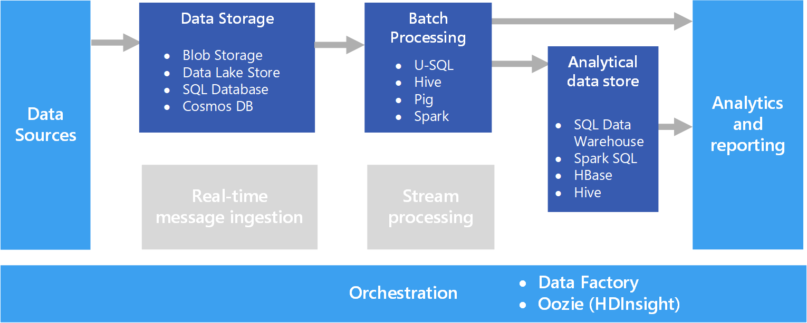
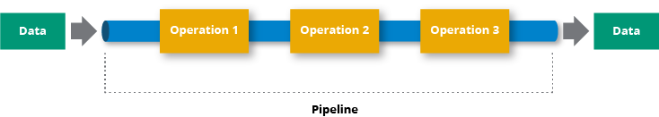
Batch-based data Pipeline
Batch data pipelines are executed manually or recurringly. In each run, they extract all data from the data source, apply operations to the data, and publish the processed data to the data sink. They are done once all data have been processed.
Typically batch data pipelines do not maintain knowledge about data changes.

Slide 13
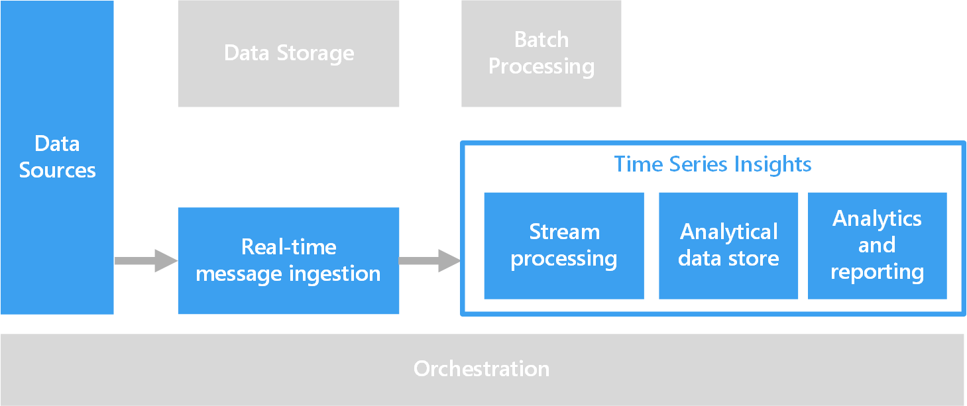
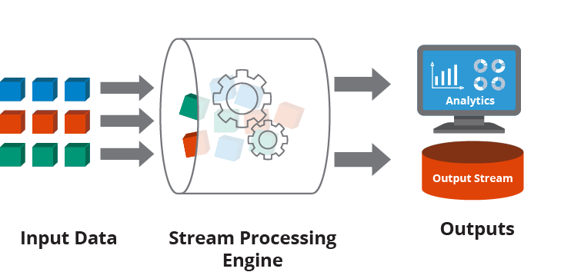
Streaming Data Pipeline
Stream processing is the practice of taking action on a series of data at the time the data is created.
Stream processing often entails multiple tasks on the incoming series of data (the “data stream”), which can be performed serially, in parallel, or both.
This workflow is referred to as a stream processing pipeline.
Stream processing is most often applied to data that is generated as a series of events, such as data from IoT sensors
Notes:
Stream processing allows applications to respond to new data events at the moment they occur. In this simplified example, input data pipeline is processed by the stream processing engine in real-time. The output data is delivered to a streaming analytics application and added to the output stream.
This workflow is referred to as a stream processing pipeline, which includes the generation of the stream data, the processing of the data, and the delivery of the data to a final location
Actions that stream processing takes on data include aggregations (e.g., calculations such as sum, mean, standard deviation), analytics (e.g., predicting a future event based on patterns in the data), transformations (e.g., changing a number into a date format), enrichment (e.g., combining the data point with other data sources to create more context and meaning), and ingestion (e.g., inserting the data into a database).
, payment processing systems, and server and application logs. Common paradigms include publisher/subscriber (commonly referred to as pub/sub) and source/sink. Data and events are generated by a publisher or source and delivered to a stream processing application, where the data may be augmented, tested against fraud detection algorithms, or otherwise transformed, before the application sends the result to a subscriber or sink. On the technical side, common sources and sinks include Apache Kafka®, big data repositories such as Hadoop, TCP sockets, and in-memory data grids such as Hazelcast IMDG.
As you might notice stream processing gives updated count in realtime, easier to implement and computationally cheaper.
However,
Accuracy: There’s a possibility of duplicate events. Remember guaranteed delivery cannot be achieved without retries and hence duplicates. With duplicate events, the count would go wrong.
Idempotency: Where there’s code, there’re bugs. So with data pipelines. It’s not uncommon to re-run the pipeline code on the same date after fixing bugs. It’s not hard to notice, the realtime update code would not be reusable since it’s not idempotent
Extensibility: Not every summary table can be designed in first go. Based on usage, we would create summary tables that are frequently used. In this scenario, we would have to feed the realtime update code.
Parallelism: It’s harder to get stream processing code to run in parallel than batch processing code.

Slide 14
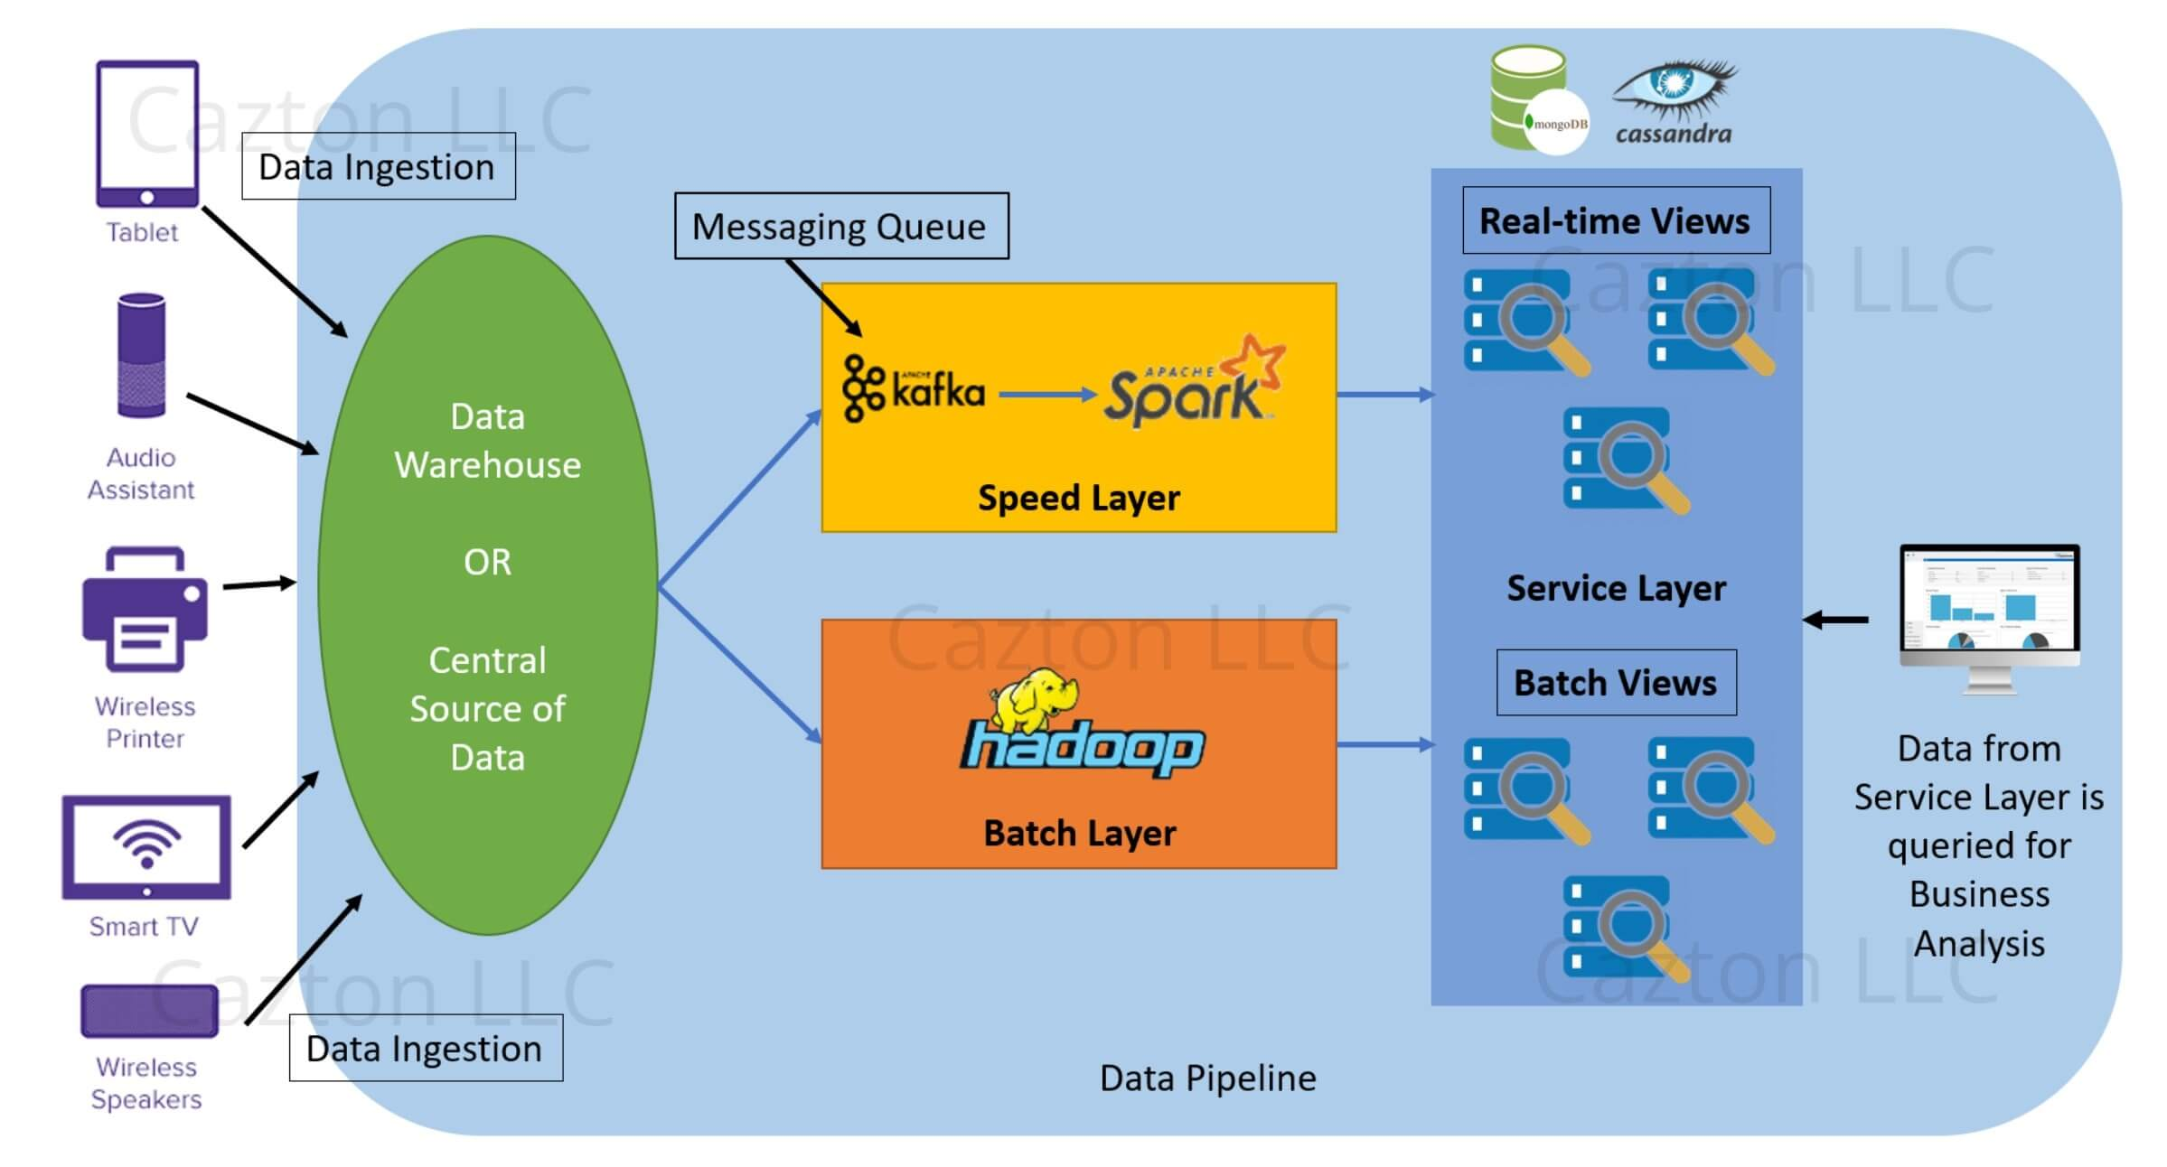
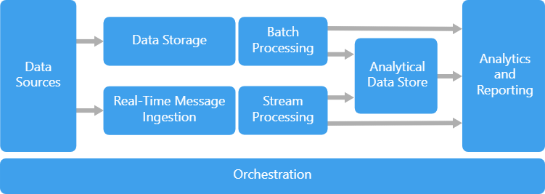
Lambda Architecture
This approach attempts to balance latency, throughput, and fault-tolerance by using batch processing to provide comprehensive and accurate views of batch data while simultaneously using real-time stream processing to provide views of online data.
Lambda architecture is a way of processing that provides access to batch-processing and stream-processing methods with a hybrid approach.
Notes:
Benefits of lambda architectures
your application can be either automatically scaled or scaled by the adjustment of its capacity
– refers to the fact that serverless applications have already built-in availability and faults tolerance. It represents a guarantee that all requests will get a response about whether they were successful or not.
React in real-time to changing business/market scenarios
Challenges with lambda architectures
Complexity – lambda architectures can be highly complex. Administrators must typically maintain two separate code bases for batch and streaming layers, which can make debugging difficult.
Batch Layer
New data comes continuously, as a feed to the data system. It gets fed to the batch layer and the speed layer simultaneously. It looks at all the data at once and eventually corrects the data in the stream layer. Here we can find lots of ETL and a traditional data warehouse. This layer is built using a predefined schedule, usually once or twice a day. The batch layer has two very important functions:To manage the master dataset
To pre-compute the batch views.
Serving Layer
The outputs from the batch layer in the form of batch views and those coming from the speed layer in the form of near real-time views get forwarded to the serving. This layer indexes the batch views so that they can be queried in low-latency on an ad-hoc basis.

Slide 15
Top Big Data challenges
Big Data Storage
Big Data Processing
“How to process big data with reasonable cost and time?”

Slide 16
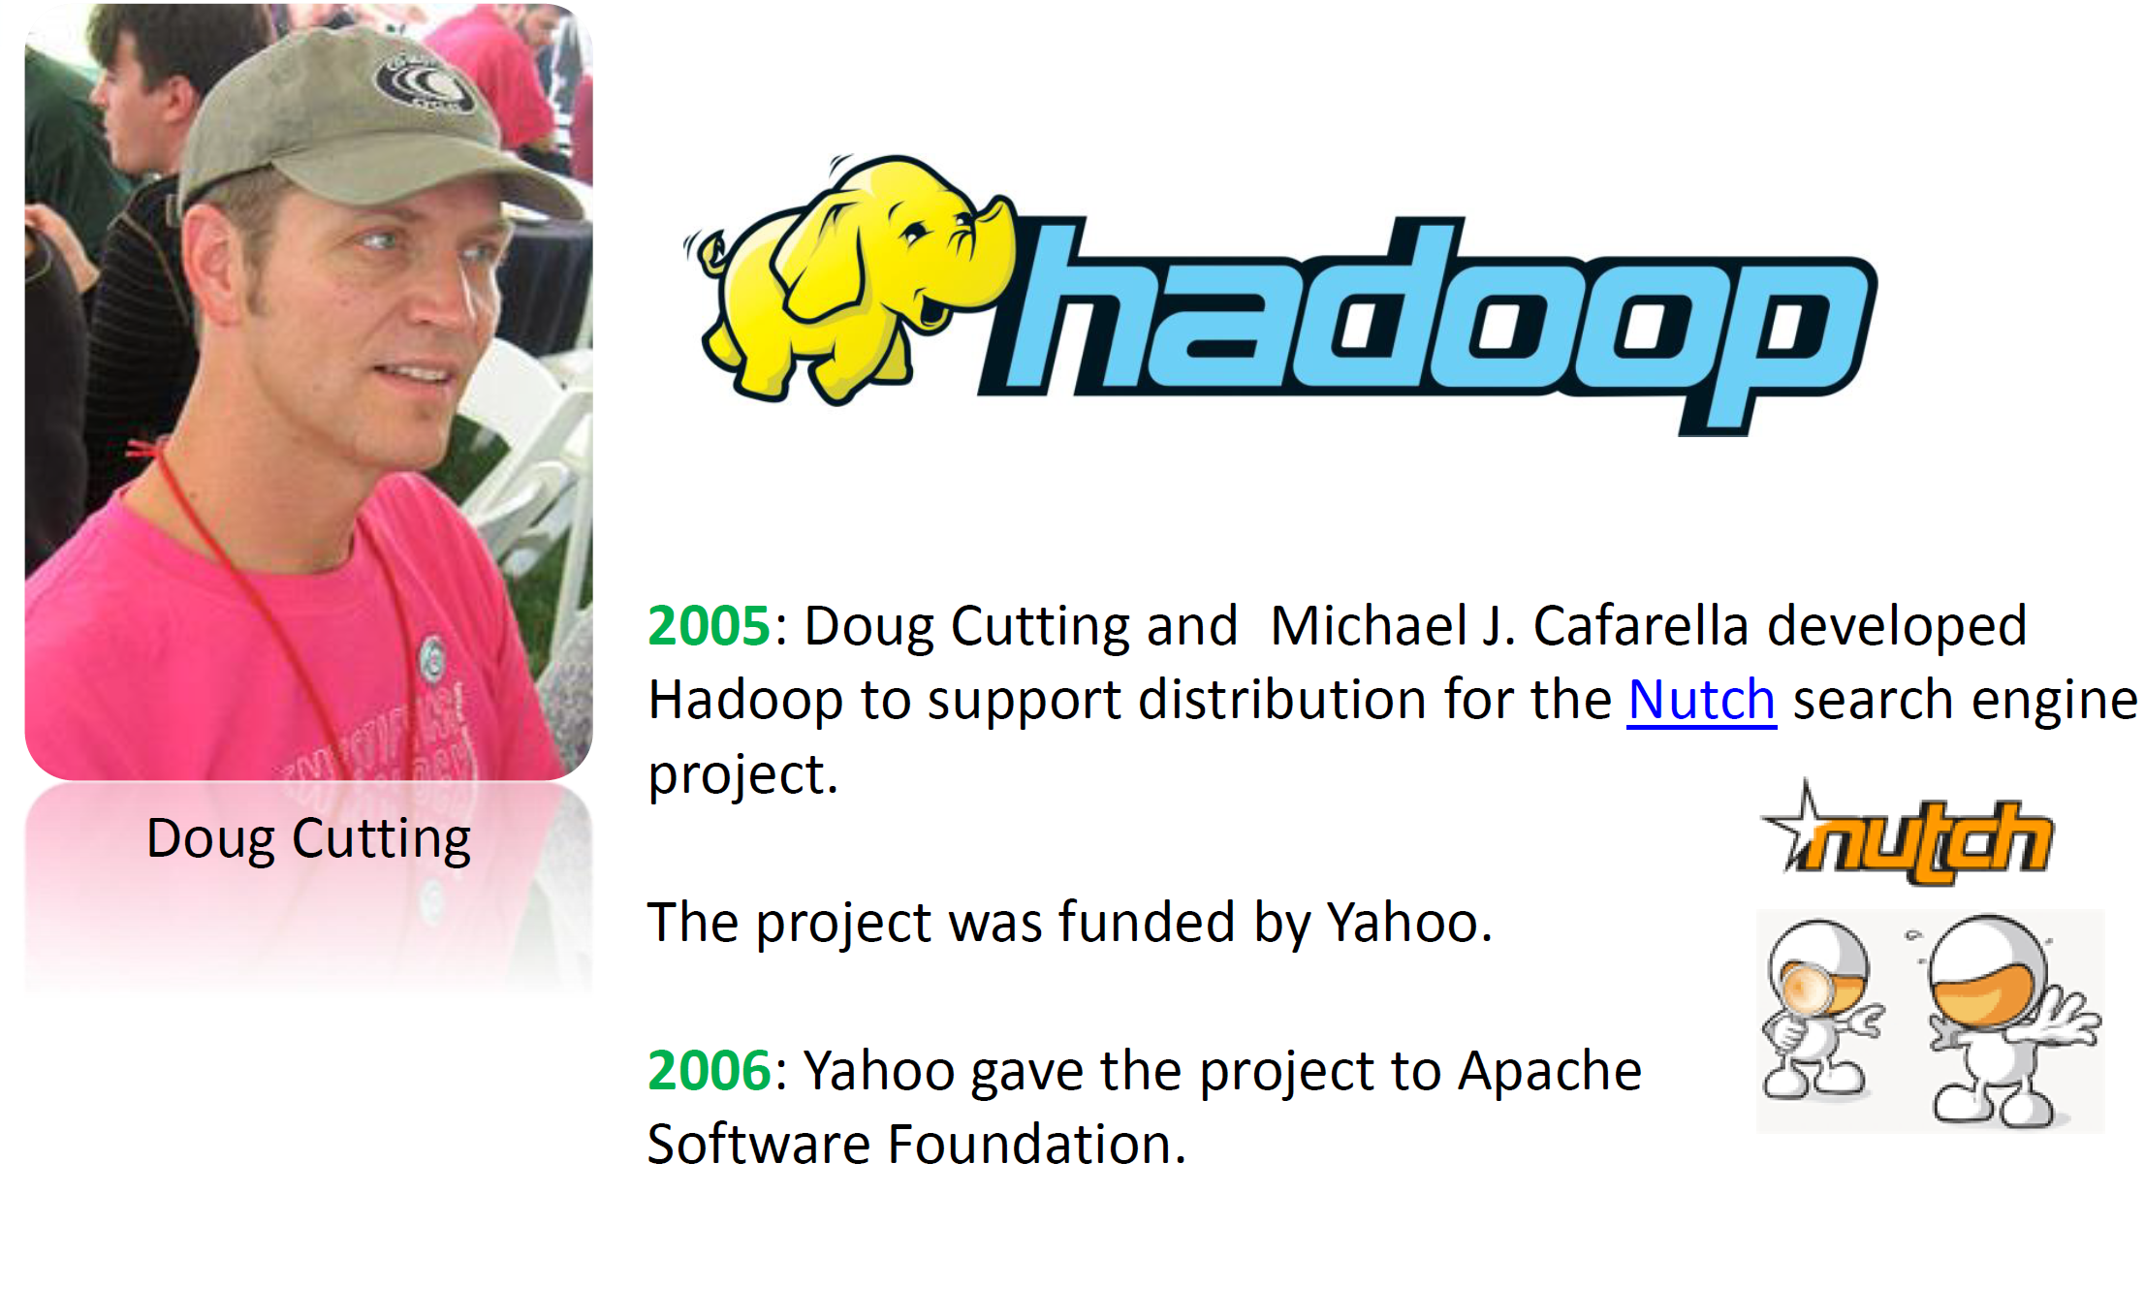
Notes:
Google file system 2003
Mapreduce 2004

Slide 17
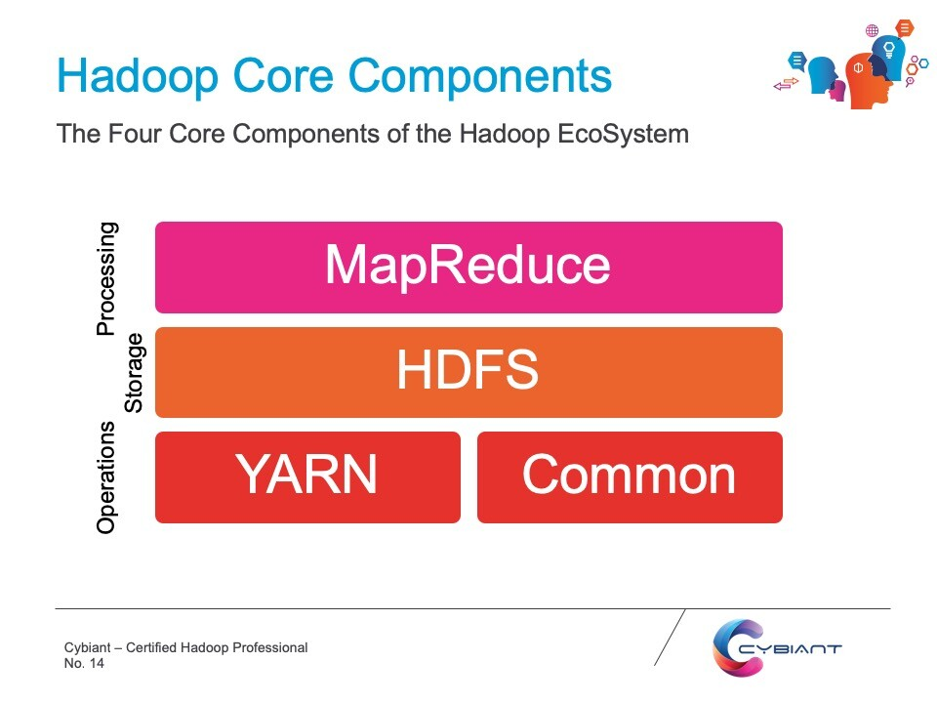


What is Hadoop?
Hadoop consists of four main modules:
Apache Hadoop is an open source framework that is used to efficiently store and process large datasets ranging in size from gigabytes to petabytes of data. Instead of using one large computer to store and process the data, Hadoop allows clustering multiple computers to analyze massive datasets in parallel more quickly(distributed computing).
Structured and non-structured data
Notes:
Petabyte of data
An open-source software framework that supports distributed applications
Abstract and facilitatethe storageand processingof large and/or rapidly growing data sets
•Structuredand non-structureddata
•High scalabilityand availability
Hadoop Common
Hadoop is a Java-based solution, meaning it has been written in Java. Hadoop Common provides the tools (in Java) for a user’s computer so that it can read the data that is stored in a Hadoop file system
Hadoop Distributed File System (HDFS)
The Hadoop Distributed File System (HDFS) is a filesystem designed for storing very large files with streaming data access patterns, running on clusters of commodity hardware.[1] This means that Hadoop stores files that are typically many terabytes up to petabytes of data. The streaming nature of HDFS means that HDFS stores data under the assumption that it will need to be read multiple times and that the speed with which the data can be read is most important. Lastly, HDFS is designed to run on commodity hardware, which is inexpensive hardware that than be sourced from different vendors.
In order to achieve these properties, HDFS breaks data down into smaller ‘blocks,’ typically of 64MB. Because of the abstraction towards blocks, there is no requirement should be stored on the same disk. Instead, they can be stored anywhere. And that is exactly what HDFS does. It stores data on different locations in network (i.e. a cluster). For that reason, it is referred to a distributed file system.
Because the blocks are stored in a cluster, the questions of fault tolerance rises? What happens if one of the connections in the network fails? Does this means that the data becomes incomplete? To address this potential problem of distributed storage, HDFS stores multiple (typically three) redundant copies of each block in the network. If a block for whatever reason becomes unavailable, a copy can be read from an alternative location. Due to this useful property, HDFS is a very fault-tolerant or robust storage system.
Hadoop MapReduce
MapReduce is a processing technique and program model that enables distributed processing of large quantities of data, in parallel, on large clusters of commodity hardware. Similar in the way that HDFS stores blocks in a distributed manner, MapReduce processes data in a distributed manner. In other words, MapReduce uses processing power in local nodes within the cluster, instead of centralized processing.
In order to accomplish this, a processing query needs to be expressed as a MapReduce job. A MapReduce job work by breaking down the processing into two distinct phases: the ‘Map’ operation and the ‘Reduce’ operation. The Map operation and takes in a set of data and subsequently converts that data in a new data set, where individual emblements are broken down into key/value pairs.
The output of the Map function is processed by the MapReduce framework, before being sent to the Reduce operation. This processing is sort and groups the key-value pairs, a process that is also known as shuffeling. Shuffling is technically embedded in the Reduce operation. The Reduce operation subsequently processes the (shuffled) output data from the Map operation and converts this into a smaller set of key/value pairs. This is the end results, which is the output of the MapReduce operation.
In summary, we could say that the MapReduce executes in three stages:
Map stage− The goal of the map operation is to process the input data. Generally the input data is in the form of file or directory and is stored in the Hadoop file system (HDFS). The input file is passed to the mapper function line by line. The map operation processes the data and creates several small chunks of data.
Shuffle stage – The goal of the shuffle operation is to order and sort key/value pairs so that they are ordered into the right sequence.
Reduce stage− The goal of the Reduce operation is to process the data that comes from the Map operation. After processing, it produces a new set of output, which will be stored in the HDFS.
The main benefit of using MapReduce is that it is able to scale quickly over large networks of computing nodes, making the processing highly efficient and quick.
Hadoop YARN
Hadoop YARN (Yet Another Resource Negotiator) is responsible for allocating system resources to the various applications running in a Hadoop cluster and scheduling tasks to be executed on different cluster nodes. It was developed because in very large clusters (with more than 4000 nodes), the MapReduce system begins to hit scalability bottlenecks.
Hadoop YARN solves the scalability problem by introducing a resource manager that manages the use of resources across a cluster. The resource manager manages the responsibilities of the JobTracker, which on its own turn schedules jobs (which data is processed when) as well as task monitoring (which processing jobs have been completed). With the addition of YARN to Hadoop, the scalability of processing data with Hadoop becomes virtually endless.

Slide 18
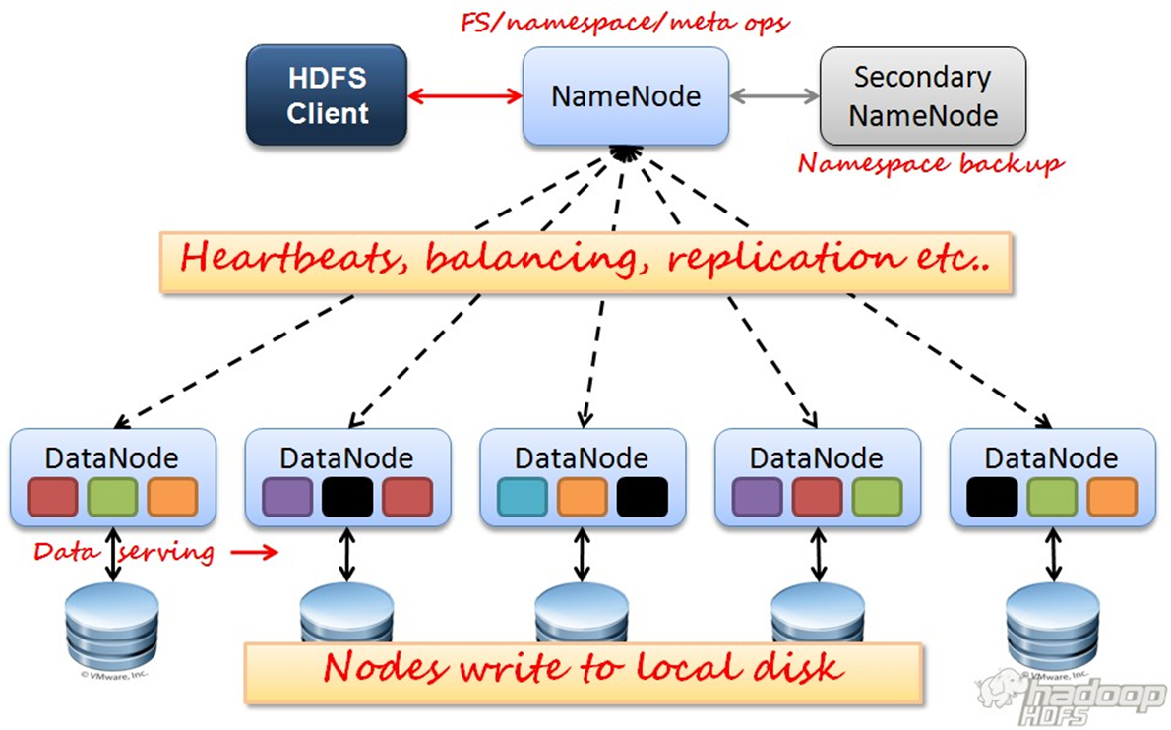

Hadoop Distributed File System (HDFS)
Very Large Distributed File System
10K nodes, 100 million files, 10PB
Assumes Commodity Hardware
Files are replicated to handle hardware failure
Detect failures and recover from them
Optimized for Batch Processing
Data locations exposed so that computations can move to where data resides
Provides very high aggregate bandwidth
Integrate well with Hadoop MapReduce, allowing data to be read and computed upon locally when possible.
Notes:
There are two (and a half) types of machines in a HDFS cluster
NameNode :– is the heart of an HDFS filesystem, it maintains and manages the file system metadata.
E.g; what blocks make up a file, and on which datanodes those blocks are stored.
DataNode :- where HDFS stores the actual data.
Failure tolerant –
data is duplicated across multiple DataNodes to protect against machine failures. The default is a replication factor of 3 (every block is stored on three machines).
Scalability –
need more disk space? Just add more DataNodes and re-balance
Industry standard –
Other distributed applications are built on top of HDFS (HBase, Map-Reduce)

Slide 19

Hadoop Distributed File System (HDFS)
HDFS has two core components:
Single NameNode : is the heart of an HDFS filesystem, it maintains and manages the file system metadata.
E.g; what blocks make up a file, and on which datanodes those blocks are stored.
A number of DataNodes: where HDFS stores the actual data. Serves read, write requests, performs block creation, deletion, and replication upon instruction from Namenode.
A file is split into one or more blocks and set of blocks are stored in DataNodes.
Notes:
NameNode, a master server that manages the file system namespace and regulates access to files by clients
DataNodes, usually one per node in the cluster, which manage storage attached to the nodes that they run on. HDFS exposes a file system namespace and allows user data to be stored in files. Internally, a file is split into one or more blocks and these blocks are stored in a set of DataNodes. The NameNode executes file system namespace operations like opening, closing, and renaming files and directories. It also determines the mapping of blocks to DataNodes. The DataNodes are responsible for serving read and write requests from the file system’s clients. The DataNodes also perform block creation, deletion, and replication upon instruction from the NameNode.

Slide 20
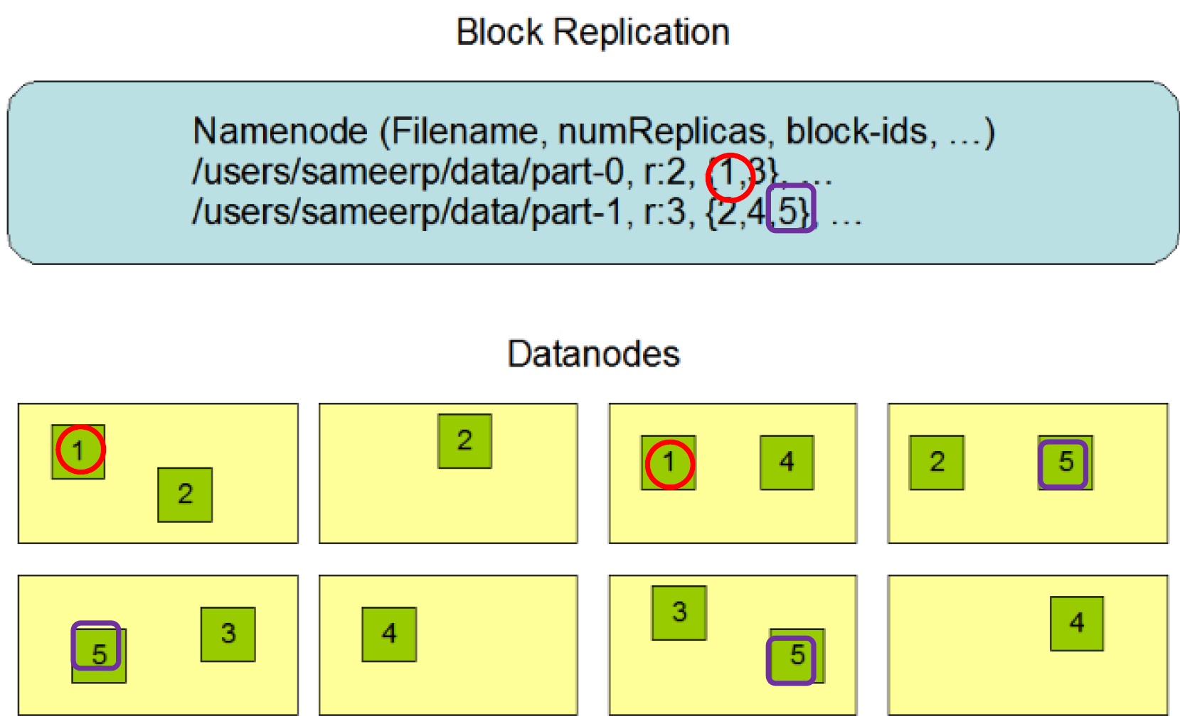
How HDFS stores files?
Each file is stored as a sequence of blocks
Each block in the file except the last block are the same size.
The blocks of a file are replicated for fault tolerance
Notes:
the NameNode creates a number of copies of each data block using the replication method. It is recommended to have at least three replicas,

Slide 21
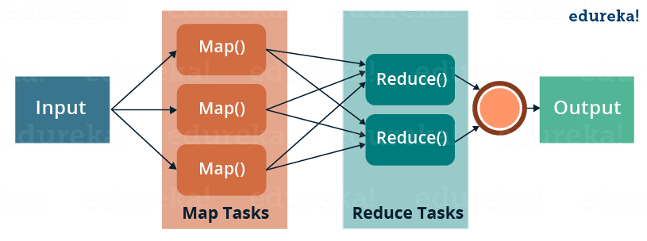
MapReduce
MapReduce is a programming model or pattern within the Hadoop framework that is used to access big data stored in the Hadoop File System (HDFS). It is a core component, integral to the functioning of the Hadoop framework.
The Map function takes input from the disk as <key,value> pairs, processes them, and produces another set of intermediate <key,value> pairs as output.
The Reduce function also takes inputs as <key,value> pairs, and produces <key,value> pairs as output.
Notes:
Map
The input data is first split into smaller blocks. Each block is then assigned to a mapper for processing. For example, if a file has 100 records to be processed, 100 mappers can run together to process one record each
Reduce
After all the mappers complete processing, the framework shuffles and sorts the results before passing them on to the reducers. A reducer cannot start while a mapper is still in progress.
There are two intermediate steps between Map and Reduce.
Combine and Partition
Combine is an optional process.. It reduces the data on each mapper
Partition is the process that translates the <key, value> pairs resulting from mappers to another set of <key, value>

Slide 22
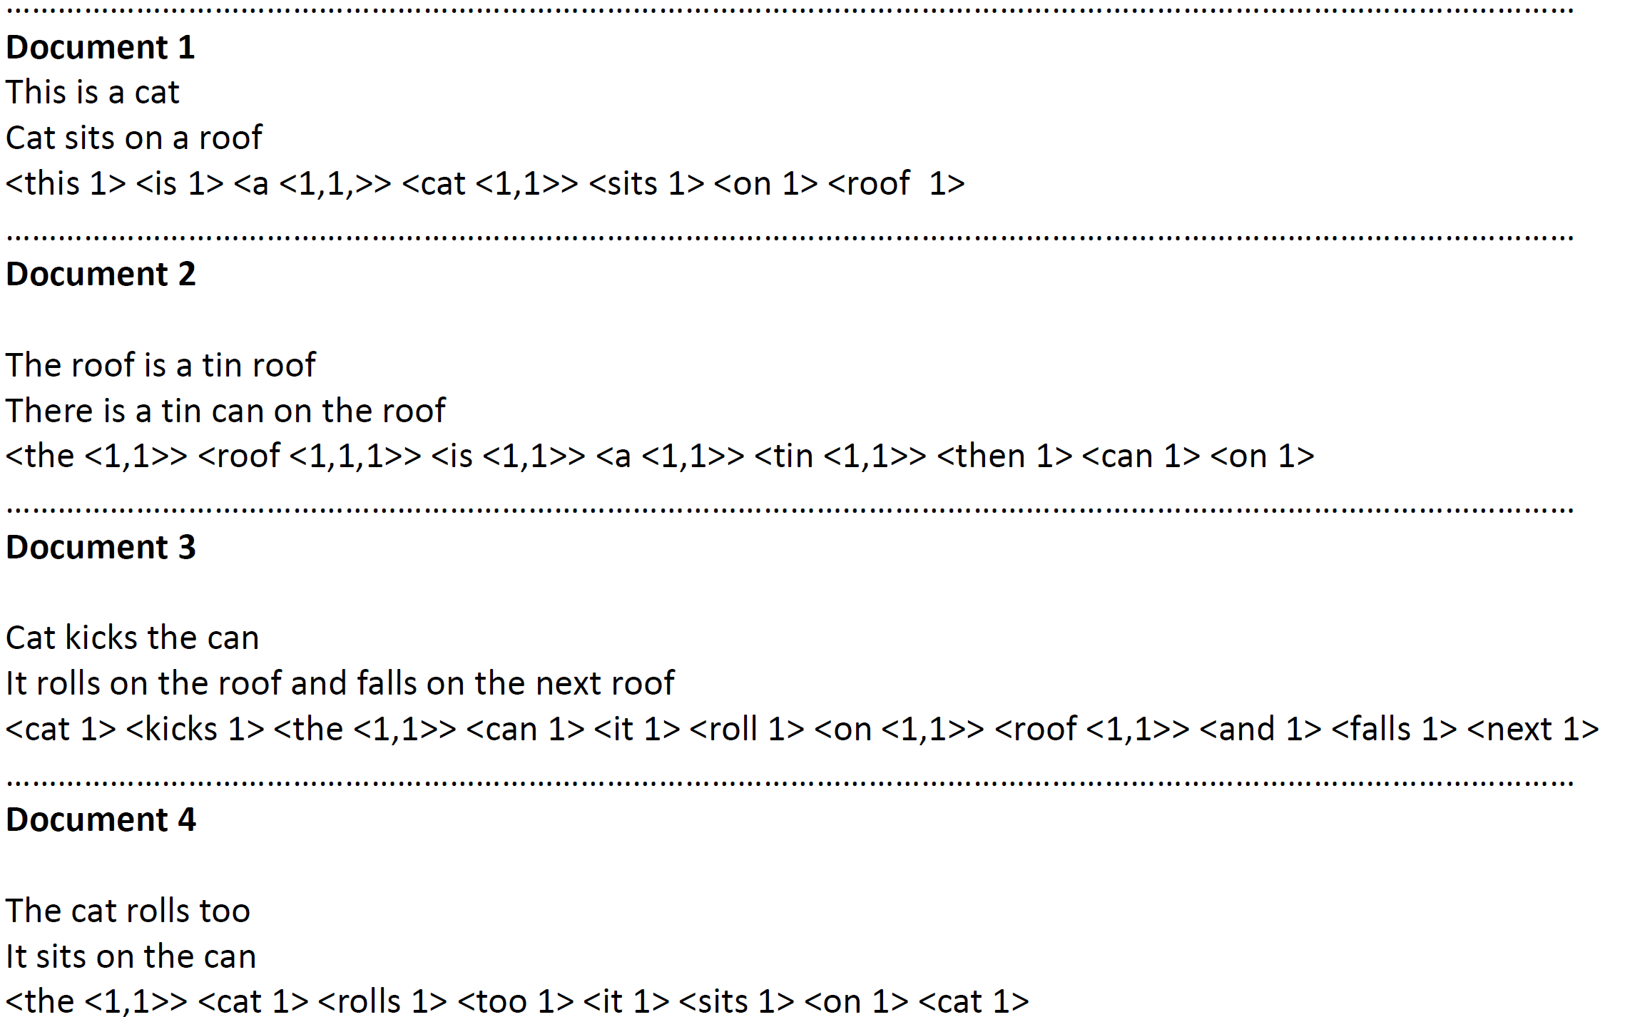
Notes:
For simplification, let's assume that the Hadoop framework runs just four mappers. Mapper 1, Mapper 2, Mapper 3, and Mapper 4. The value input to the mapper is one record of the log file. The key could be a text string such as

Slide 23
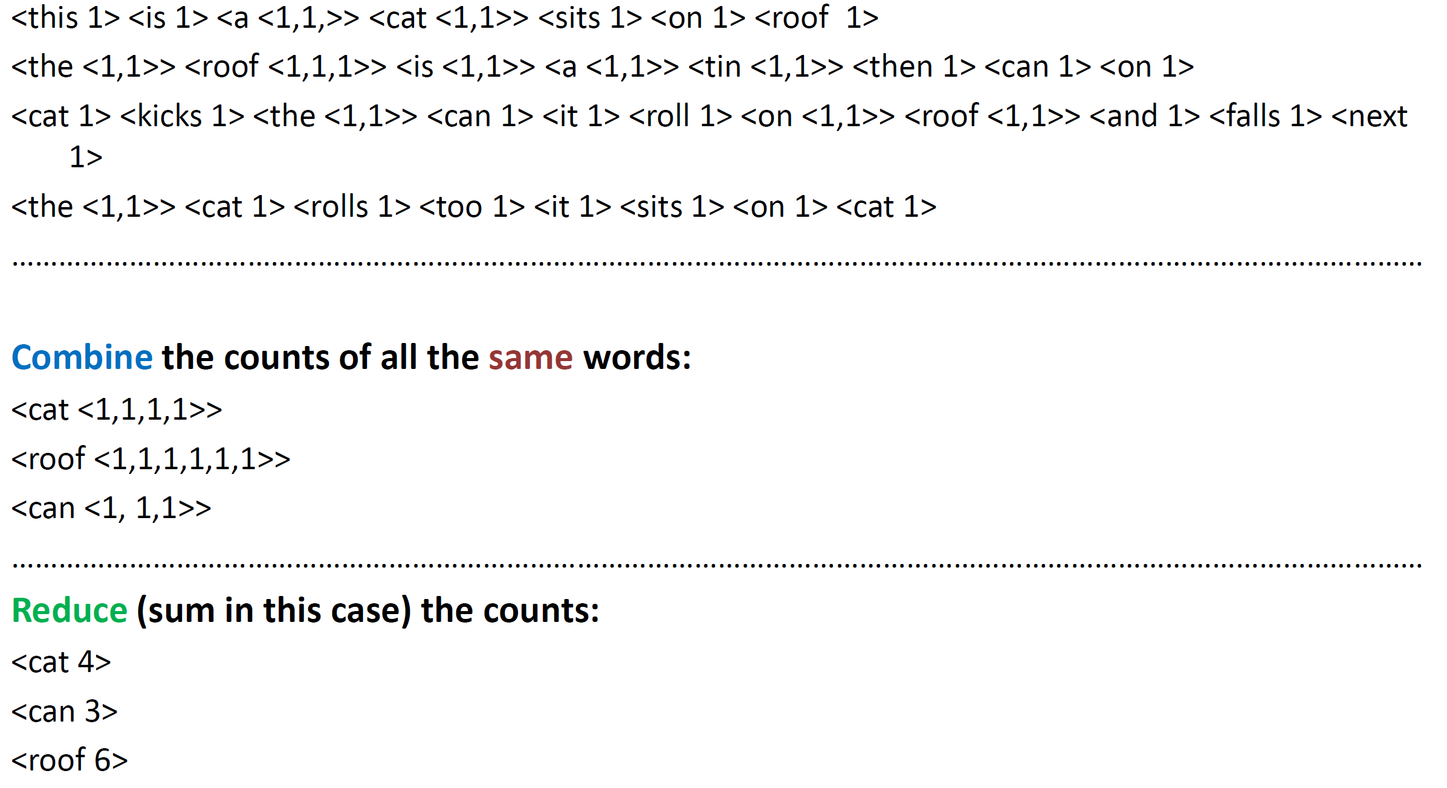

Slide 24
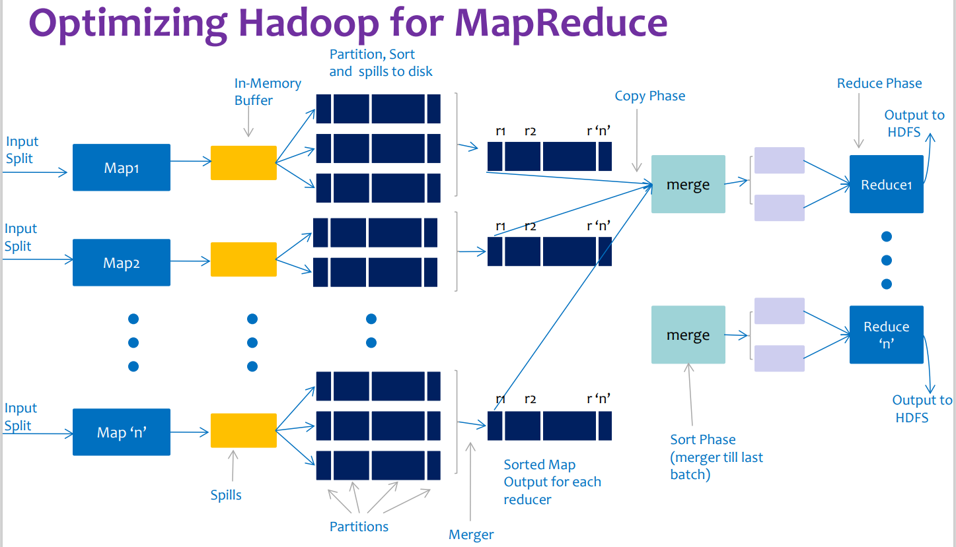

Slide 25
YARN
The fundamental idea of YARN is to split up the functionalities of resource management and job scheduling/monitoring into separate daemons. The idea is to have a global Resource Manager
Resource Manager containers are allocations of physical resources
Application Manager: monitoring the application progress
Node Manager: takes care of individual nodes
Scheduler: schedules the tasks.
Notes:
Component:
Resource Manager Containers CPU cores, RAM.
when a single job is submitted, it is called an application. Monitoring the application progress, application status tracking, negotiation of resources with resource manager is the responsibility of the application manager.
The node manager takes care of individual nodes in the Hadoop cluster
Based on Resource Availability, Scheduler schedules the tasks.

Slide 26

What is Spark?
Apache Spark is an open-source tool
This framework can run in a standalone mode or on a cloud or cluster manager, and other platforms.
It is designed for fast performance and uses RAM for caching and processing data.
The Spark engine was created to improve the efficiency of MapReduce and keep its benefits. Even though Spark does not have its file system, it can access data on many different storage solutions. The data structure that Spark uses is called Resilient Distributed Dataset, or RDD.
Can absorb live data streams from Kafka, Flume, ZeroMQ, etc.
Resilient Distributed datasets(RDD): is the fundamental data structure of Spark
Notes:
Spark performs different types of big data workloads. This includes MapReduce-like batch processing, as well as real-time stream processing, machine learning, graph computation, and interactive queries. With easy to use high-level APIs, Spark can integrate with many different libraries, including PyTorch and TensorFlow. To learn the difference between these two libraries, check out our article on PyTorch vs. TensorFlow.
RDD: The RDDs store data in memory for fast access to data during computation.. it uses RAM) to cache and process data instead of a file system. Data in memory when it is needed (but caching data is always in the cache)

Slide 27
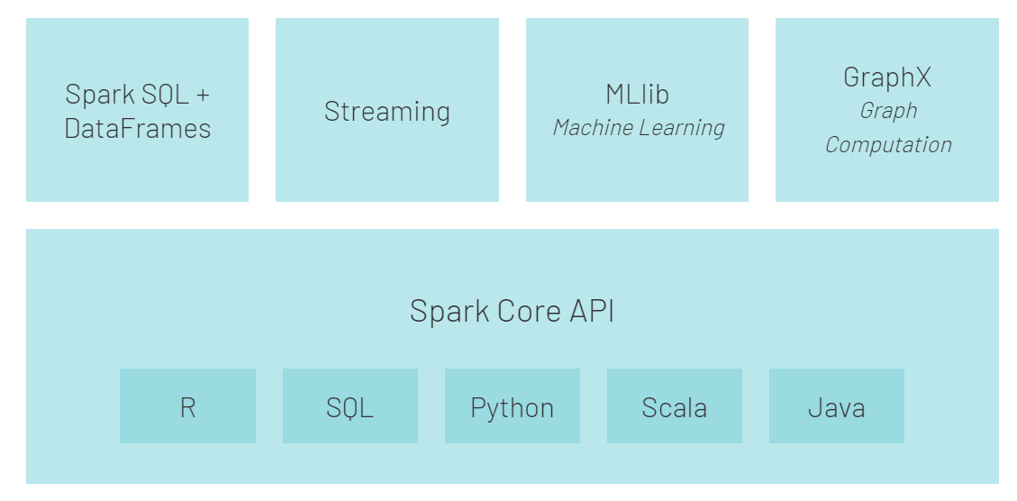
Apache Spark Ecosystem
Spark Core
Spark SQL
Spark Streaming
MLlib(Machine learning lib)
GraphX
Notes:
There are five main components of Apache Spark:
Apache Spark Core. The basis of the whole project. Spark Core is responsible for necessary functions such as scheduling, input and output operations, fault recovery, etc. Other functionalities are built on top of it.
Spark Streaming. This component enables the processing of live data streams. Data can originate from many different sources, including Kafka, Kinesis, Flume, etc.
Spark SQL. Spark uses this component to gather information about the structured data and how the data is processed.
Machine Learning Library (MLlib). This library consists of many machine learning algorithms. MLlib’s goal is scalability and making machine learning more accessible.
GraphX. A set of APIs used for facilitating graph analytics tasks.

Slide 28
Hadoop vs. Spark
Performance
By accessing the data stored locally on HDFS, Hadoop boosts the overall performance. However, it is not a match for Spark’s in-memory processing.
Spark appears to be 100x faster when using RAM for computing than Hadoop with MapReduce.
Cost
Both platforms are open-source and completely free.
Since Hadoop relies on any type of disk storage for data processing, the cost of running it is relatively low.
On the other hand, Spark depends on in-memory computations for real-time data processing.
Hadoop infrastructure is more cost-effective.
Data Processing
Hadoop is more suitable for batch processing. In contrast, Spark shines with real-time processing.
Hadoop’s goal is to store data on disks and then analyze it in parallel in batches across a distributed environment.
With the in-memory computations and high-level APIs, Spark effectively handles live streams of unstructured data.
Scalability
Hadoop uses HDFS to deal with big data.
Spark has to rely on HDFS when data is too large to handle.
8000 machines in a Spark environment with petabytes of data. When speaking of Hadoop clusters, they are well known to accommodate tens of thousands of machines and close to an exabyte of data.
Hadoop vs Spark: Detailed Comparison of Big Data Frameworks (phoenixnap.com)c
Notes:
By accessing the data stored locally on HDFS, Hadoop boosts the overall performance. However, it is not a match for Spark’s in-memory processing. According to Apache’s claims, Spark appears to be 100x faster when using RAM for computing than Hadoop with MapReduce. The dominance remained with sorting the data on disks. Spark was 3x faster and needed 10x fewer nodes to process 100TB of data on HDFS. This benchmark was enough to set the world record in 2014.
The main reason for this supremacy of Spark is that it does not read and write intermediate data to disks but uses RAM. Hadoop stores data on many different sources and then process the data in batches using MapReduce. All of the above may position Spark as the absolute winner. However, if the size of data is larger than the available RAM, Hadoop is the more logical choice
Cost
Comparing Hadoop vs. Spark with cost in mind, we need to dig deeper than the price of the software. Both platforms are open-source and completely free. Nevertheless, the infrastructure, maintenance, and development costs need to be taken into consideration to get a rough Total Cost of Ownership (TCO).
The most significant factor in the cost category is the underlying hardware you need to run these tools. Since Hadoop relies on any type of disk storage for data processing, the cost of running it is relatively low.
On the other hand, Spark depends on in-memory computations for real-time data processing. So, spinning up nodes with lots of RAM increases the cost of ownership considerably.
Another concern is application development. Hadoop has been around longer than Spark and is less challenging to find software developers.
The points above suggest that Hadoop infrastructure is more cost-effective. While this statement is correct, we need to be reminded that Spark processes data much faster. Hence, it requires a smaller number of machines to complete the same task.

Slide 29
Hadoop vs. Spark
Fault Tolerance
both provide a respectable level of handling failures.
Hadoop has fault tolerance as the basis of its operation.
Spark uses RDD blocks to achieve fault tolerance.
Security
Hadoop is the clear winner. Hadoop works with multiple authentication and access control methods.
You can improve the security of Spark by introducing authentication via shared secret or event logging.
Machine Learning
Machine learning is an iterative process that works best by using in-memory computing. For this reason, Spark proved to be a faster solution in this area.
The reason for this is that Hadoop MapReduce splits jobs into parallel tasks that may be too large for machine-learning algorithms
Ease of Use and Programming Language Support
Spark provides support for multiple languages next to the native language (Scala): Java, Python, R, and Spark SQL.
The Hadoop framework is based on Java. The two main languages for writing MapReduce code is Java or Python
Spark wins in the ease-of-use section
Hadoop vs Spark: Detailed Comparison of Big Data Frameworks (phoenixnap.com)
Notes:
By accessing the data stored locally on HDFS, Hadoop boosts the overall performance. However, it is not a match for Spark’s in-memory processing. According to Apache’s claims, Spark appears to be 100x faster when using RAM for computing than Hadoop with MapReduce. The dominance remained with sorting the data on disks. Spark was 3x faster and needed 10x fewer nodes to process 100TB of data on HDFS. This benchmark was enough to set the world record in 2014.
The main reason for this supremacy of Spark is that it does not read and write intermediate data to disks but uses RAM. Hadoop stores data on many different sources and then process the data in batches using MapReduce. All of the above may position Spark as the absolute winner. However, if the size of data is larger than the available RAM, Hadoop is the more logical choice
Cost
Comparing Hadoop vs. Spark with cost in mind, we need to dig deeper than the price of the software. Both platforms are open-source and completely free. Nevertheless, the infrastructure, maintenance, and development costs need to be taken into consideration to get a rough Total Cost of Ownership (TCO).
The most significant factor in the cost category is the underlying hardware you need to run these tools. Since Hadoop relies on any type of disk storage for data processing, the cost of running it is relatively low.
On the other hand, Spark depends on in-memory computations for real-time data processing. So, spinning up nodes with lots of RAM increases the cost of ownership considerably.
Another concern is application development. Hadoop has been around longer than Spark and is less challenging to find software developers.
The points above suggest that Hadoop infrastructure is more cost-effective. While this statement is correct, we need to be reminded that Spark processes data much faster. Hence, it requires a smaller number of machines to complete the same task.

Slide 30

Big Data Infrastructure

Slide 31
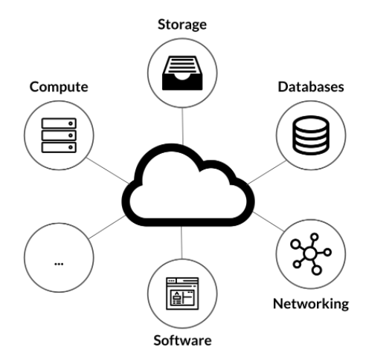
Cloud Computing
Simply put, cloud computing is the delivery of computing services including servers, storage, databases, networking, software, analytics, and intelligence over the Internet (“the cloud”) to offer faster innovation, flexible resources, and economies of scale.
Cloud can be public, private or hybrid.
Types of cloud services:
Infrastructure as a service (IaaS)
Platform as a service (PaaS)
Software as a service (SaaS)
Types of Cloud Computing (crucial.com.au)
Notes:
With IaaS, you rent IT infrastructure—servers and virtual machines (VMs), storage, networks, operating systems—from a cloud provider on a pay-as-you-go basis.
Platform as a service refers services that supply an on-demand for developing, testing, delivering, and managing software applications. PaaS is designed to make it easier for developers to quickly create web or mobile apps, without worrying about setting up or managing the underlying infrastructure of servers, storage, network, and databases needed for development.
Software as a service is a method for delivering software applications over the Internet. With SaaS, cloud providers host and manage the software application and infrastructure, and handle maintenance, like software upgrades and security patching. Users connect to the application over the Internet, usually with a web browser on their phone, tablet, or PC.

Slide 32
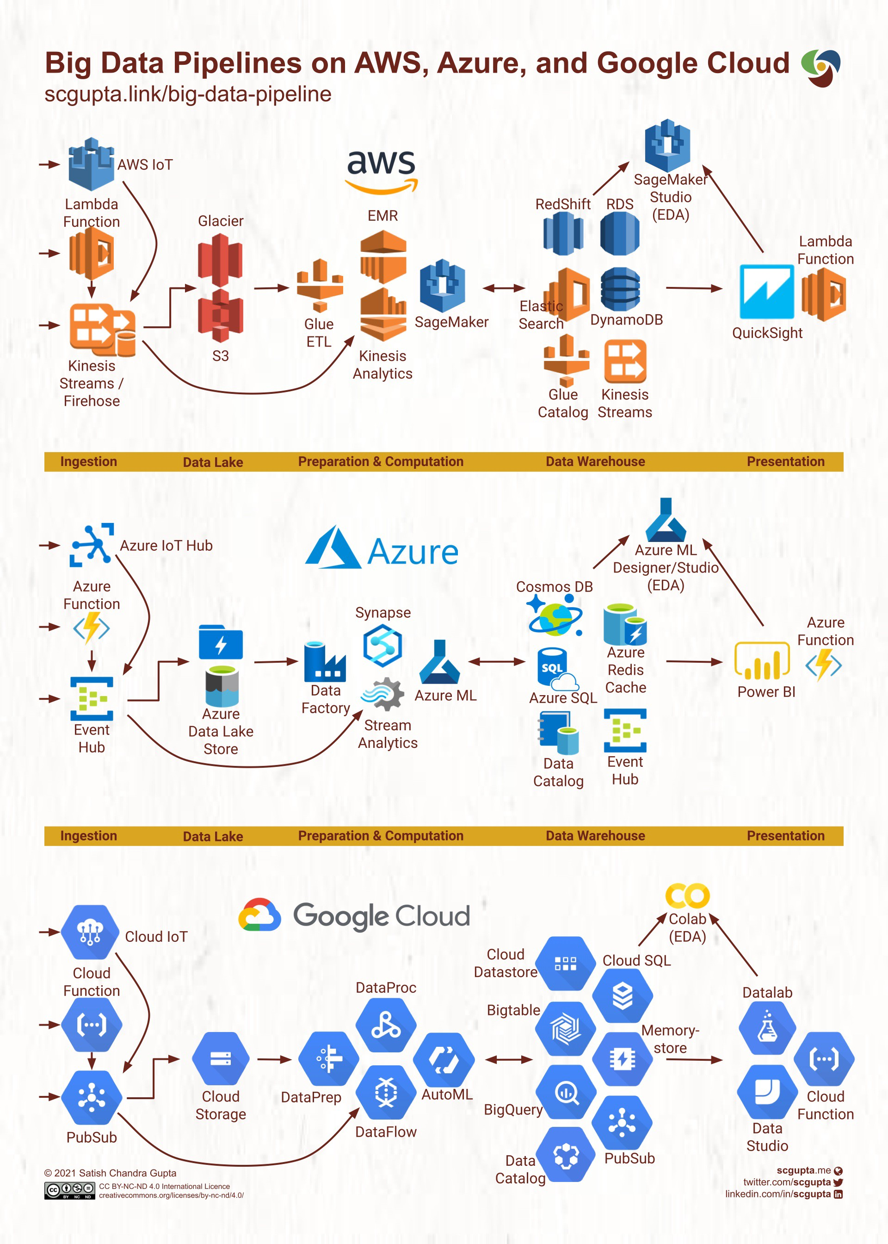
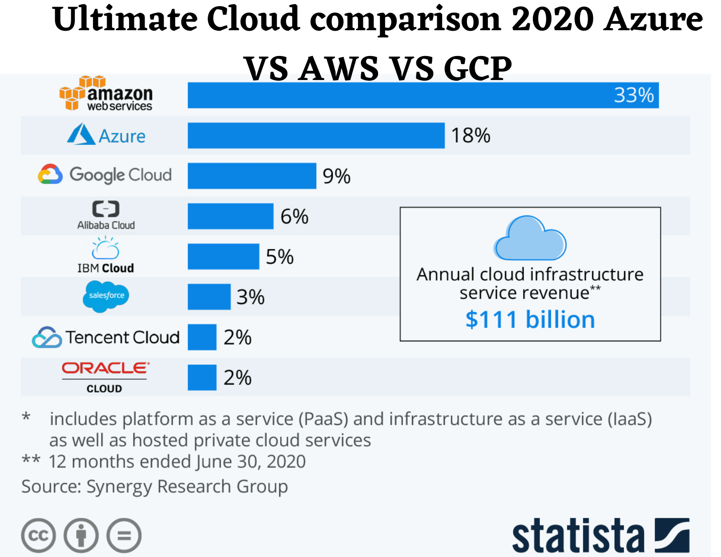
Notes:
Scalable Efficient Big Data Pipeline Architecture | Towards Data Science

Slide 33
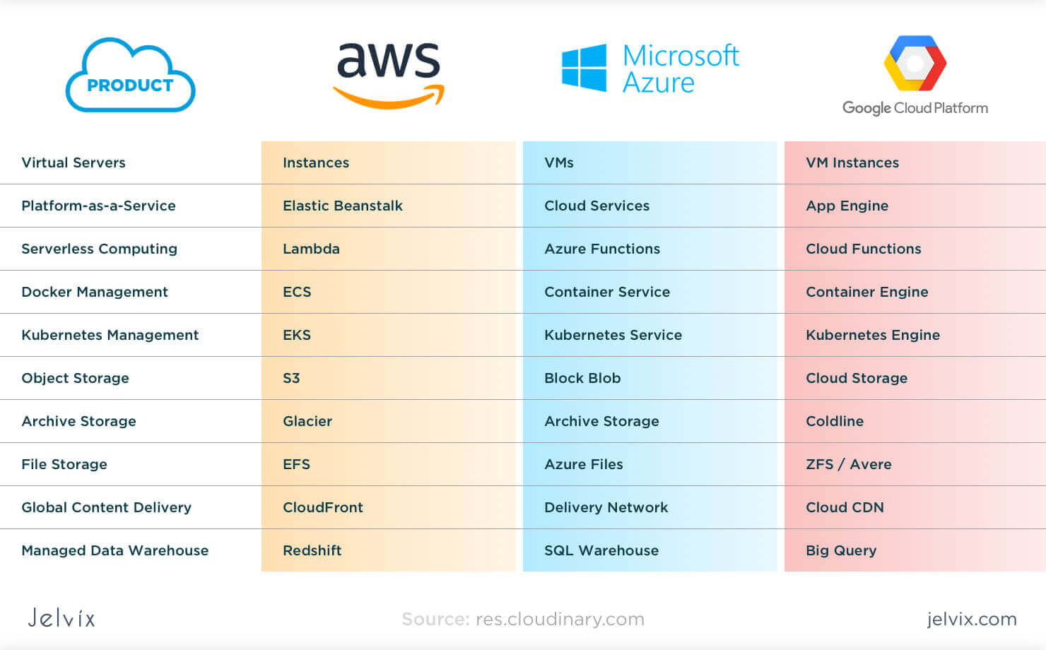

Slide 34
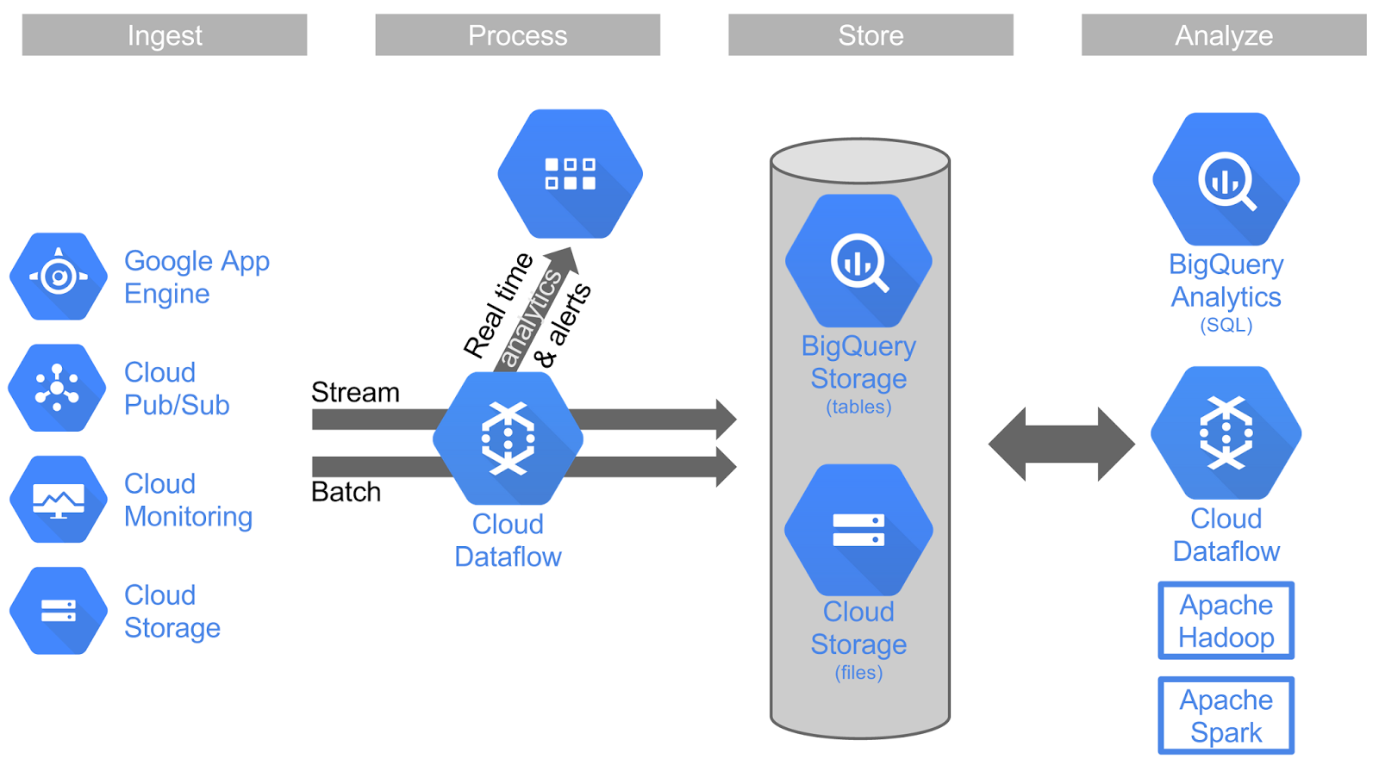
Google Could Platform (GCP)

Slide 35
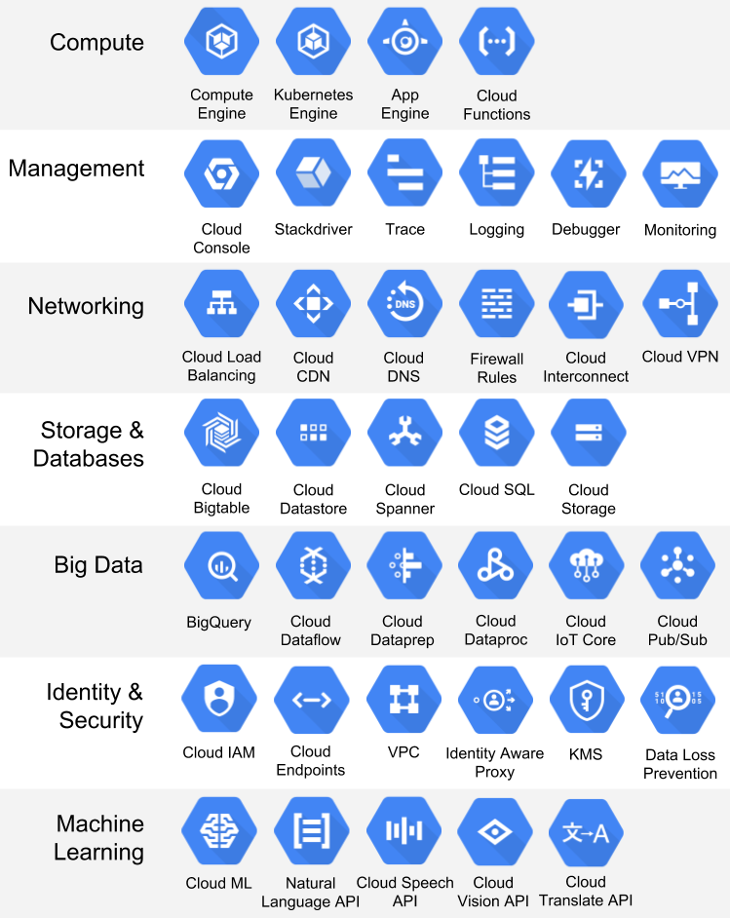
GCP Services

Slide 36
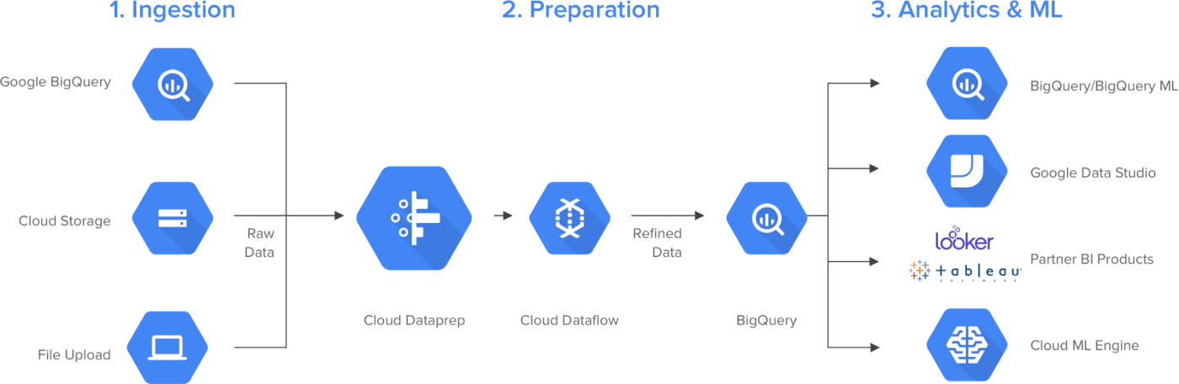
GCP Big Data Pipeline

Slide 37
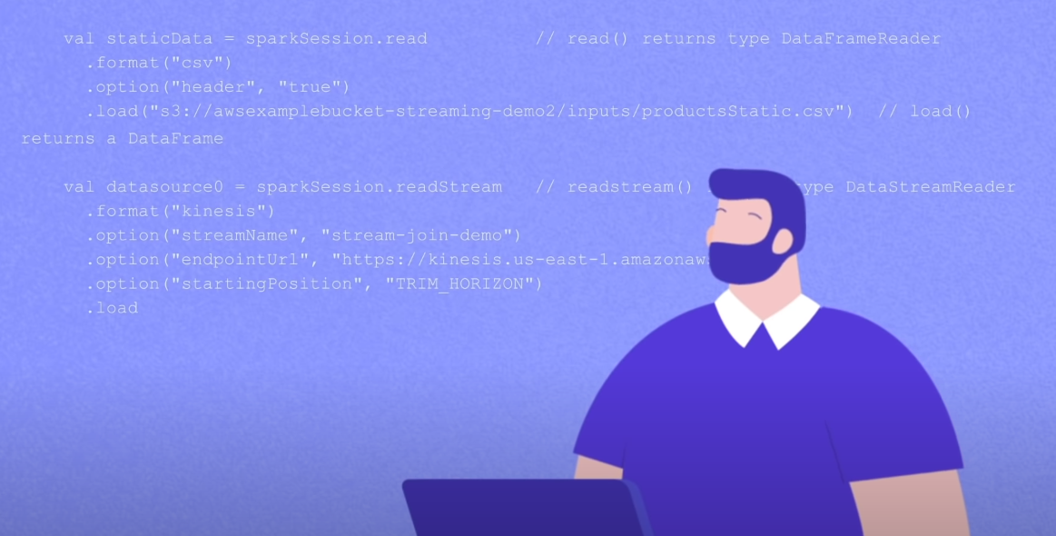
End….
Notes:
dd

Slide 38
For etl, data prep and data integration : Apach spark
Data warehouse: snowflake, oracle, redshift
Data lakes: Ibm,
Batch scheduler: airflow, lowigi , askaban
Stream: flink, apache spark, kafka, storm, amazon kenises

Slide 39
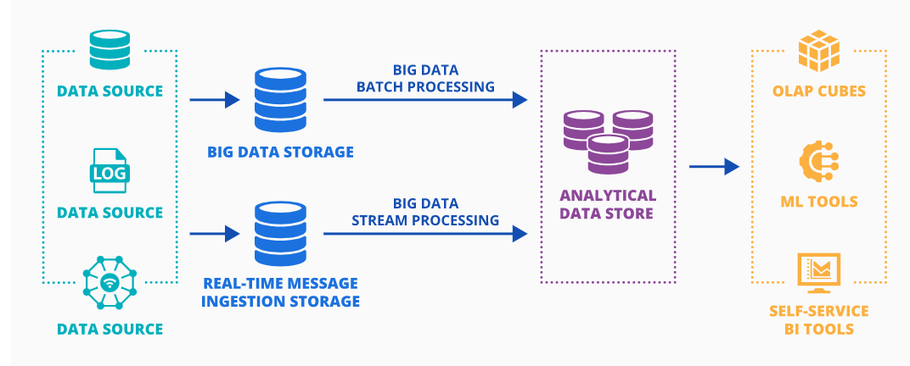
Top 5 Big Data Databases in 2022: Features, Benefits, Pricing (scnsoft.com)
Notes:
Big data architecture may include the following components:
Data sources – relational databases, files (e.g., web server log files) produced by applications, real-time data produced by IoT devices.
Big data storage – NoSQL databases for storing high data volumes of different types before filtering, aggregating and preparing data for analysis.
Real-time message ingestion store – to capture and store real-time messages for stream processing.
Analytical data store – relational databases for preparing and structuring big data for further analytical querying.
Big data analytics and reporting, which may include OLAP cubes, ML tools, self-service BI tools, etc. – to provide big data insights to end users.

Slide 40
What Is Real-Time Stream Processing? – Hazelcast
What is Event Stream Processing? How & When to Use It – Hazelcast
What is Streaming ETL? Scenarios for Real-Time ETL - Hazelcast

Slide 41
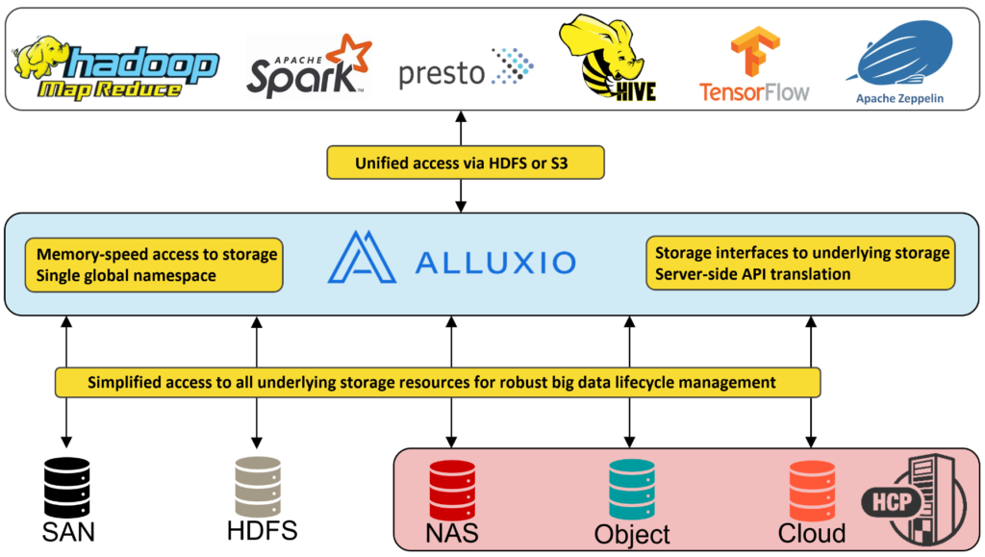

Slide 42
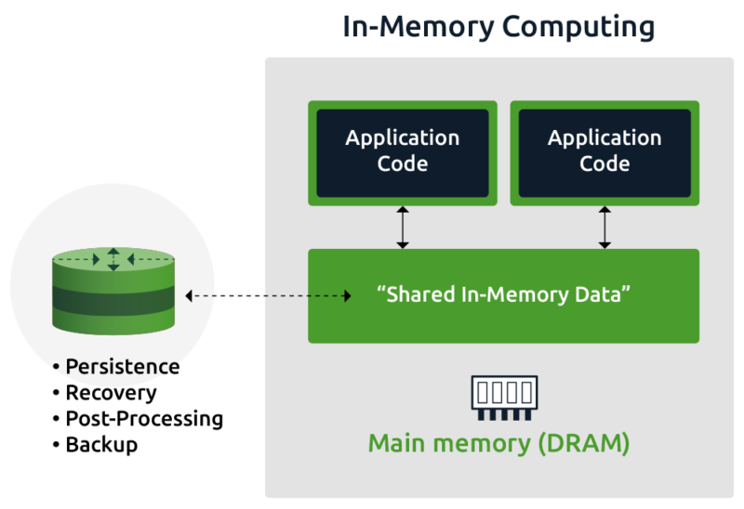
In-Memory Computation
In-memory computation (or in-memory computing) is the technique of running computer calculations entirely in computer memory (e.g., in RAM). This term typically implies large-scale, complex calculations which require specialized systems software to run the calculations on computers working together in a cluster. As a cluster, the computers pool together their RAM so the calculation is essentially run across computers and leverages the collective RAM space of all the computers together.
Notes:
In-memory computation works by eliminating all slow data accesses and relying exclusively on data stored in RAM. Overall computation performance is greatly improved by removing the latency commonly seen when accessing hard disk drives or SSDs. Software running on one or more computers manages the computation as well as the data in memory, and in the case of multiple computers, the software divides the computation into smaller tasks which are distributed out to each computer to run in parallel. In-memory computation is often done in the technology known as in-memory data grids (IMDG). One such example is Hazelcast IMDG, which lets users run complex computations on large data sets across a cluster of hardware servers while maintaining extreme speed.

Slide 43
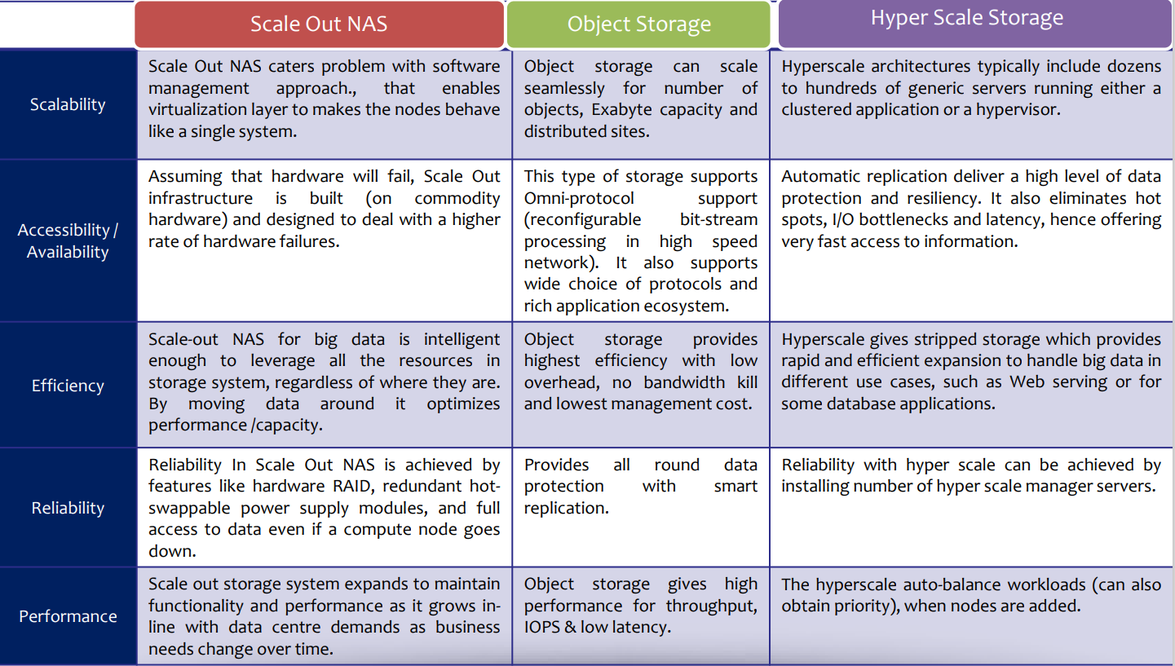
Traditional Storage

Slide 44
Data Storage: is the persistence and management of data in a scalable way that satisfies the needs of applications that require fast access to the data. Relational Database Management Systems (RDBMS) have been the main, and almost unique, solution to the storage paradigm for nearly 40 years. However, the ACID (Atomicity, Consistency, Isolation, and Durability) properties that guarantee database transactions lack flexibility with regard to schema changes and the performance and fault tolerance when data volumes and complexity grow, making them unsuitable for big data scenarios. NoSQL technologies have been designed with the scalability goal in mind and present a wide range of solutions based on alternative data models. A more detailed discussion of data storage is provided in Chapter 6.

Slide 45
Big Data Analytics
Big Data analytics involves the cleaning, transformation and modeling of data, for the discovery of information useful for making decisions. The information obtained from the big data analytics tools includes correlations, hidden patterns, customer preferences, and market trends. A variety of sophisticated applications with elements such as statistical algorithms, predictive models, etc. are often used. Below are some of the data analysis technologies you should know.

Slide 46
Autmation(run at the time and speed) = orgestration(run them in coordination)

Slide 47
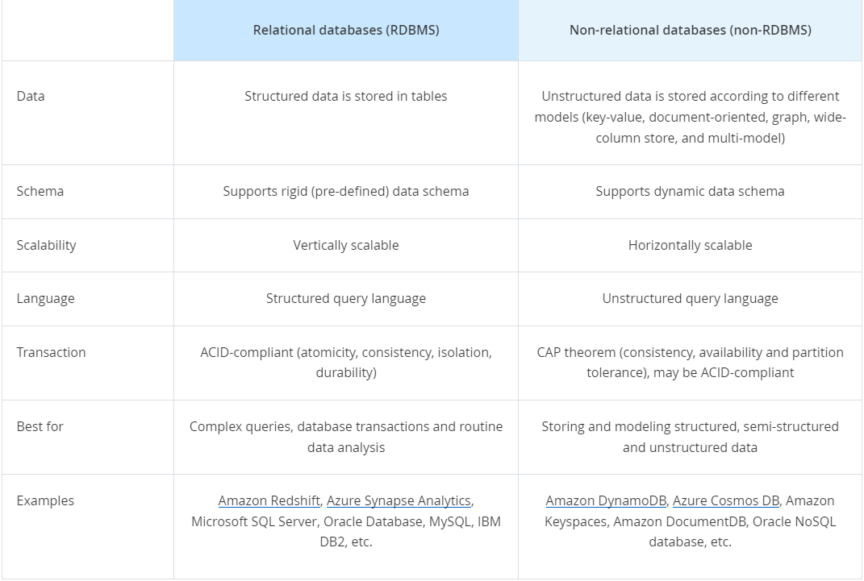

Slide 48
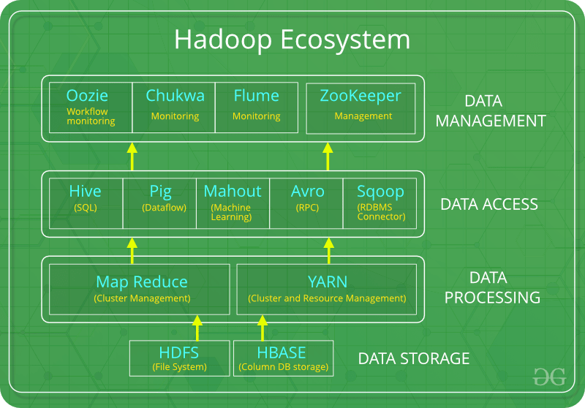
Notes:
The Apache Hadoop Project consists of four main modules:
HDFS – Hadoop Distributed File System. This is the file system that manages the storage of large sets of data across a Hadoop cluster. HDFS can handle both structured and unstructured data. The storage hardware can range from any consumer-grade HDDs to enterprise drives.
MapReduce. The processing component of the Hadoop ecosystem. It assigns the data fragments from the HDFS to separate map tasks in the cluster. MapReduce processes the chunks in parallel to combine the pieces into the desired result.
YARN. Yet Another Resource Negotiator. Responsible for managing computing resources and job scheduling.
Hadoop Common. The set of common libraries and utilities that other modules depend on. Another name for this module is Hadoop core, as it provides support for all other Hadoop components.

Slide 49
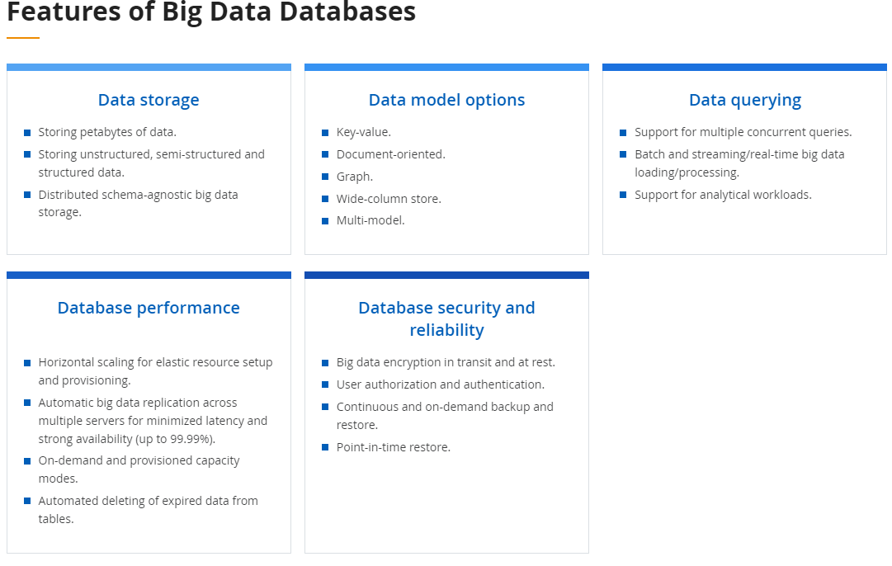

Slide 50
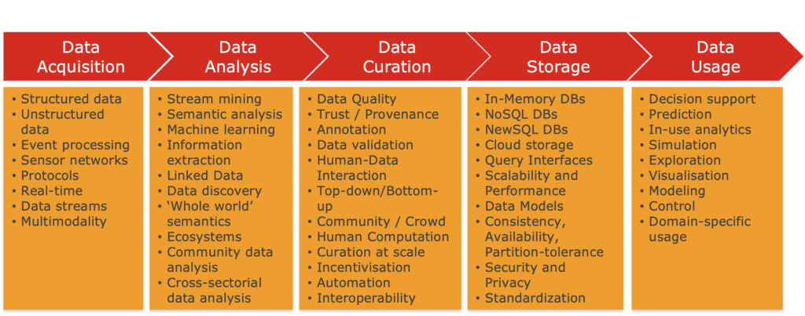

Slide 51
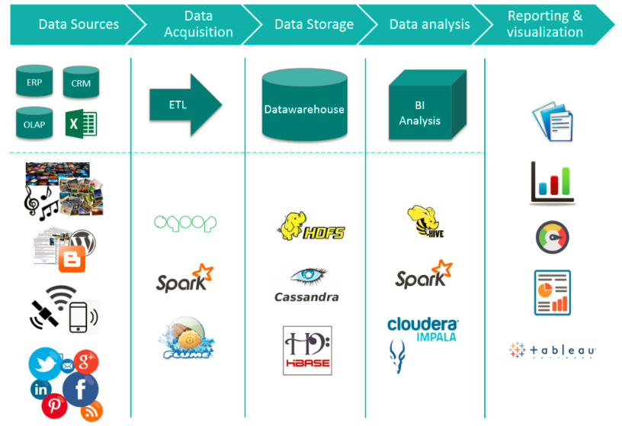

Slide 52

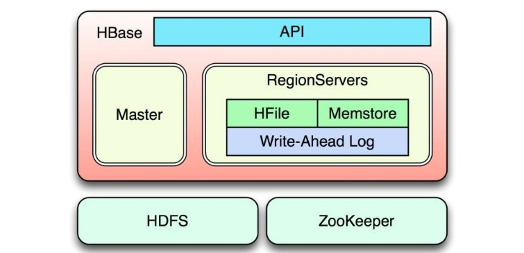
HBase Architecture
Notes:
Hbase uses HDFS as its reliable storage layer
Native Java API, Gateway for REST
Master manages cluster
RegionServer manage data
Zookeepr is used to coordinate clusters

Slide 53
1. Volume of Data Leverage Data Lakes
Provide storage for a large amount of raw data in its native format; it’s tagged with unique identifiers and metadata,
The same repository of raw data can be used for different use cases.
A query returns a smaller subset of data to answer the question.
Sharing the same data lake for different purposes adds flexibility to the organization without the overhead cost of redundant, purpose-specific data marts.
Notes:
Data lakes provide powerful capabilities to meet different requirements from the same repository of raw data. A data lake stores a large amount of raw data in its native format; it’s tagged with unique identifiers and metadata, but it’s still raw. When a business question is asked, the data is queried and the appropriate, smaller subset of data is returned to answer the question. This is in contrast to data marts, which offer a pre-built subset of data designed for a specific use case; in many situations the siloed nature of data marts is a liability.
The power of the data lake is that the same repository of raw data can be used for different use cases. Data scientists can use the data lake for their research while business analysts access more curated and governed datasets for their operational requirements. Sharing the same data lake for different purposes adds flexibility to the organization without the overhead cost of redundant, purpose-specific data marts.

